Slide 1


ISO 14001:2015 Internal Auditor Training
Version: 1.0
Course Code: TGS-2025054479
Website: https://www.tertiarycourses.com.sg/
This material belongs to Tertiary Infotech Academy Pte Ltd (UEN: 201200696W). All Rights Reserved

Slide 2
Digital Attendance (Mandatory)
It is mandatory for you to take both AM, PM and Assessment digital attendance for WSQ funded courses.
The trainer or administrator will show you the digital attendance QR code generated from SSG portal.
Please scan the QR code from your mobile phone camera and submit your attendance.
This material belongs to Tertiary Infotech Academy Pte Ltd (UEN: 201200696W). All Rights Reserved

Slide 3
About the Trainer
This material belongs to Tertiary Infotech Academy Pte Ltd (UEN: 201200696W). All Rights Reserved

Slide 4

Let's Know Each Other...
This material belongs to Tertiary Infotech Academy Pte Ltd (UEN: 201200696W). All Rights Reserved

Slide 5
Ground Rules
Set your mobile phone to silent mode
Actively participate in the class. No question is stupid.
Respect each other views. Agree to disagree.
Each person should only speak one at a time.
Be punctual. Back from breaks on time.
Exit the class silently if you need to step out for phone call, toilet break etc.
75% attendance is required for WSQ funding eligibility.
This material belongs to Tertiary Infotech Academy Pte Ltd (UEN: 201200696W). All Rights Reserved

Slide 6
Skills Framework
TSC Title: Internal Audit Engagement Planning
TSC Code: ACC-IAD-3005-1.1
TSC Description: LO1
Proficiency Level: Level 1
Learning Outcomes:
  LU1 (Introduction to ISO 14001:2015)
  LO1: This learning outcome enables participants to understand and apply the foundational principles of ISO 14001:2015 stan...
  LU2 (Auditing Methodologies)
  LO2: This learning outcome focuses on developing practical skills in applying internal audit methodologies and procedures ...
  LU3 (Risk Assessment Techniques)
  LO3: This learning outcome empowers participants to support and conduct preliminary risk assessments using established ris...
This material belongs to Tertiary Infotech Academy Pte Ltd (UEN: 201200696W). All Rights Reserved

Slide 7
Knowledge & Ability Statements
LU1: Introduction to ISO 14001:2015
  K1: International Professional Practices Framework (IPPF) comprising definitions of Internal Auditing, Code of Ethics, core principles and Internationa...
  K2: Organisation's significant risks, objectives, resources, operations, businesses and structure
  A1: Identify relevant frameworks, guidelines and standards to be applied in the engagement
LU2: Auditing Methodologies
  K3: Internal audit methodologies and procedures of the organisation
  A2: Identify stages of the engagement and various stakeholders involved
LU3: Risk Assessment Techniques
  K4: Risk identification and assessment techniques
  A3: Support conduct of preliminary survey and risk assessment
This material belongs to Tertiary Infotech Academy Pte Ltd (UEN: 201200696W). All Rights Reserved

Slide 8
Course Outline
LU1: Introduction to ISO 14001:2015
  T1: ISO 14001:2015 Internal Auditor Framework
LU2: Auditing Methodologies
  T1: Auditing ISO 14001:2015
LU3: Risk Assessment Techniques
  T1: Risk Assessment
This material belongs to Tertiary Infotech Academy Pte Ltd (UEN: 201200696W). All Rights Reserved

Slide 9
Assessment Methods & Briefing
Assessment: Written Assessment
Assessment format: Open Book
Open book assessment allows you to reference your learning materials.
Duration: As per course schedule
Grading: Competent / Not Yet Competent
Assessment Rules:
  Place phones & other materials under the table
  No photos or recording of assessment scripts
  No discussion with other learners during assessment
  Raise your hand if you have any questions
This material belongs to Tertiary Infotech Academy Pte Ltd (UEN: 201200696W). All Rights Reserved

Slide 10
Criteria for Funding
Minimum attendance rate of 75% based on SSG Digital Attendance record.
Complete the assessment and be assessed as 'Competent'.
Complete the TRAQOM survey.
For more information on WSQ funding:
Visit SkillsFuture portal: www.skillsfuture.gov.sg
Eligible individuals may use SkillsFuture Credit to offset course fees.
This material belongs to Tertiary Infotech Academy Pte Ltd (UEN: 201200696W). All Rights Reserved

Slide 11
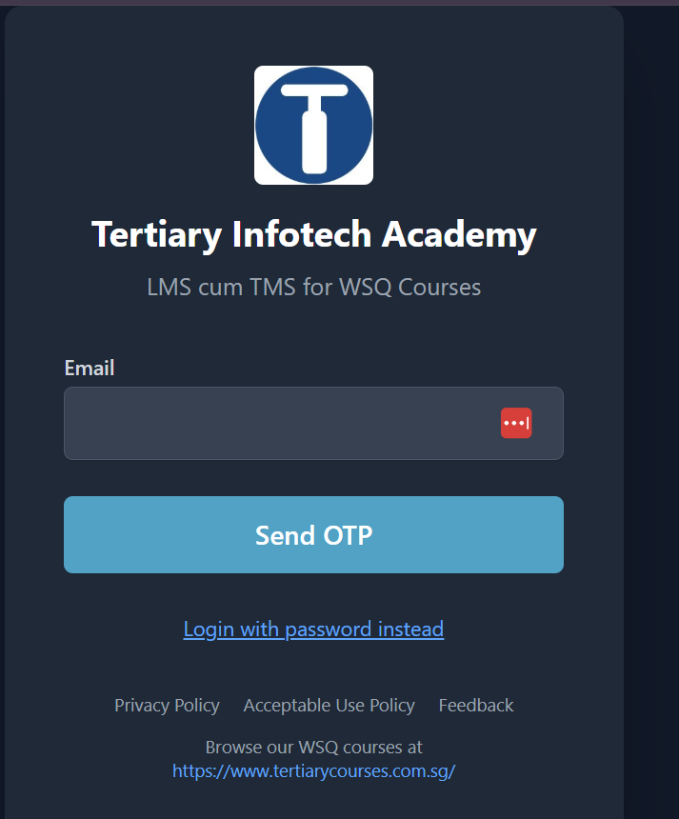
LMS/TMS
https://lms-tms.tertiaryinfotech.com

Slide 12
LO1 | LU1 | T1: ISO 14001:2015 Internal Auditor Framework

Slide 13
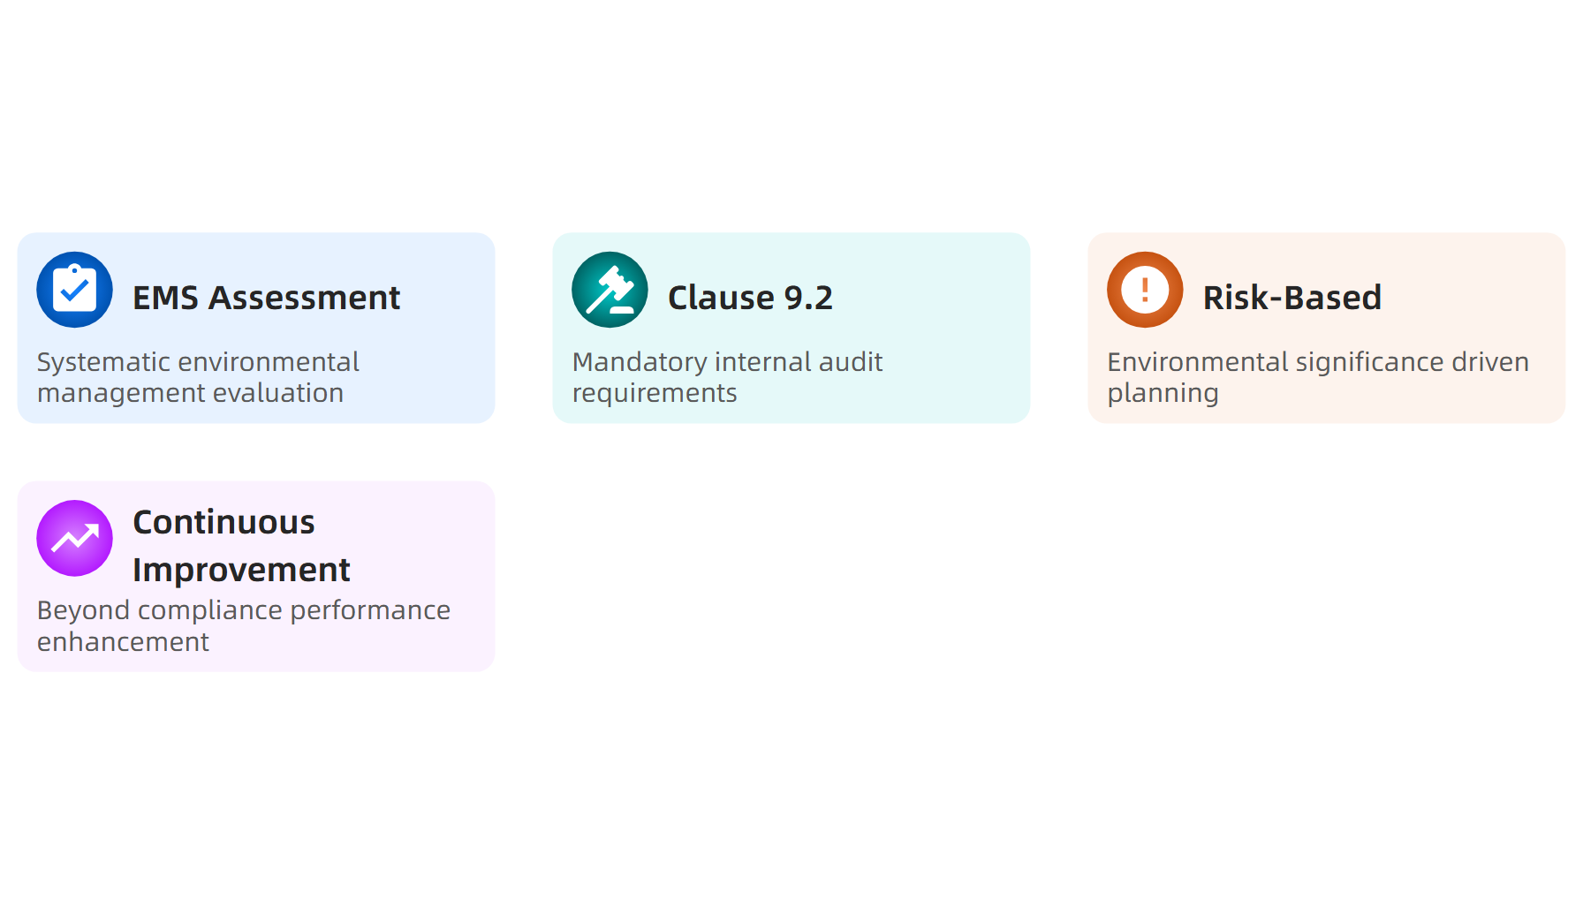
What is ISO 14001:2015 Internal Auditor Framework?
Source: ISO 14001:2015 Standard
This material belongs to Tertiary Infotech Academy Pte Ltd (UEN: 201200696W). All Rights Reserved

Slide 14
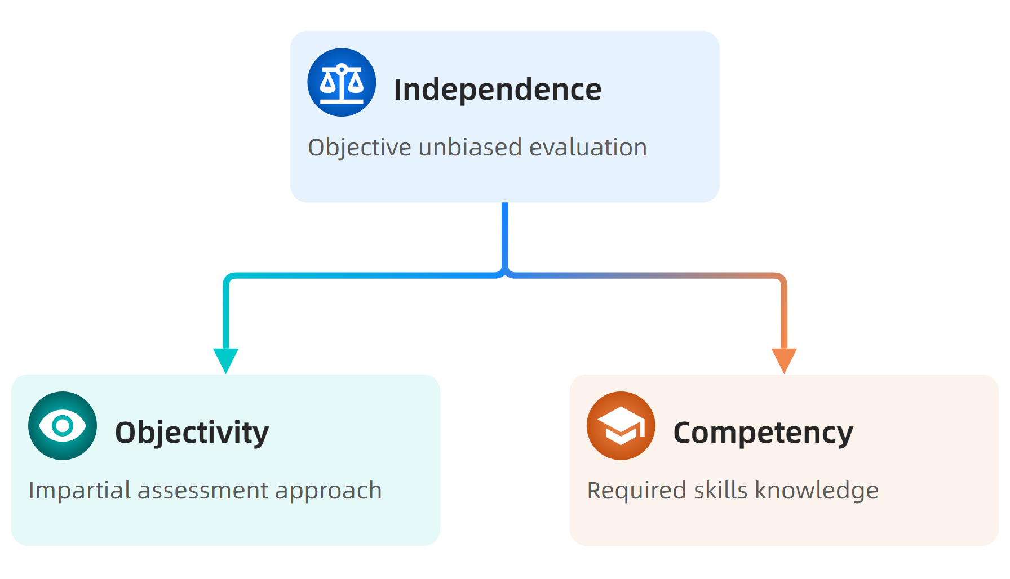
Core Framework Principles
Source: NSF Internal Auditor Training, 2024
This material belongs to Tertiary Infotech Academy Pte Ltd (UEN: 201200696W). All Rights Reserved

Slide 15
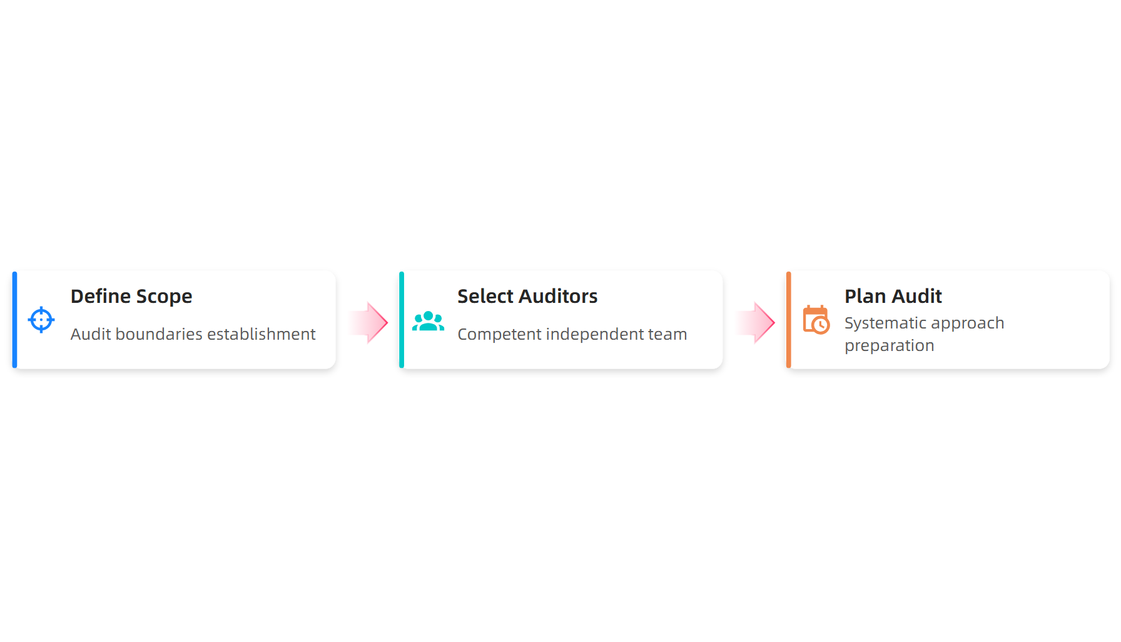
Internal Audit Process Flow
Source: ISO 14001:2015 Procedure Guidelines
This material belongs to Tertiary Infotech Academy Pte Ltd (UEN: 201200696W). All Rights Reserved

Slide 16
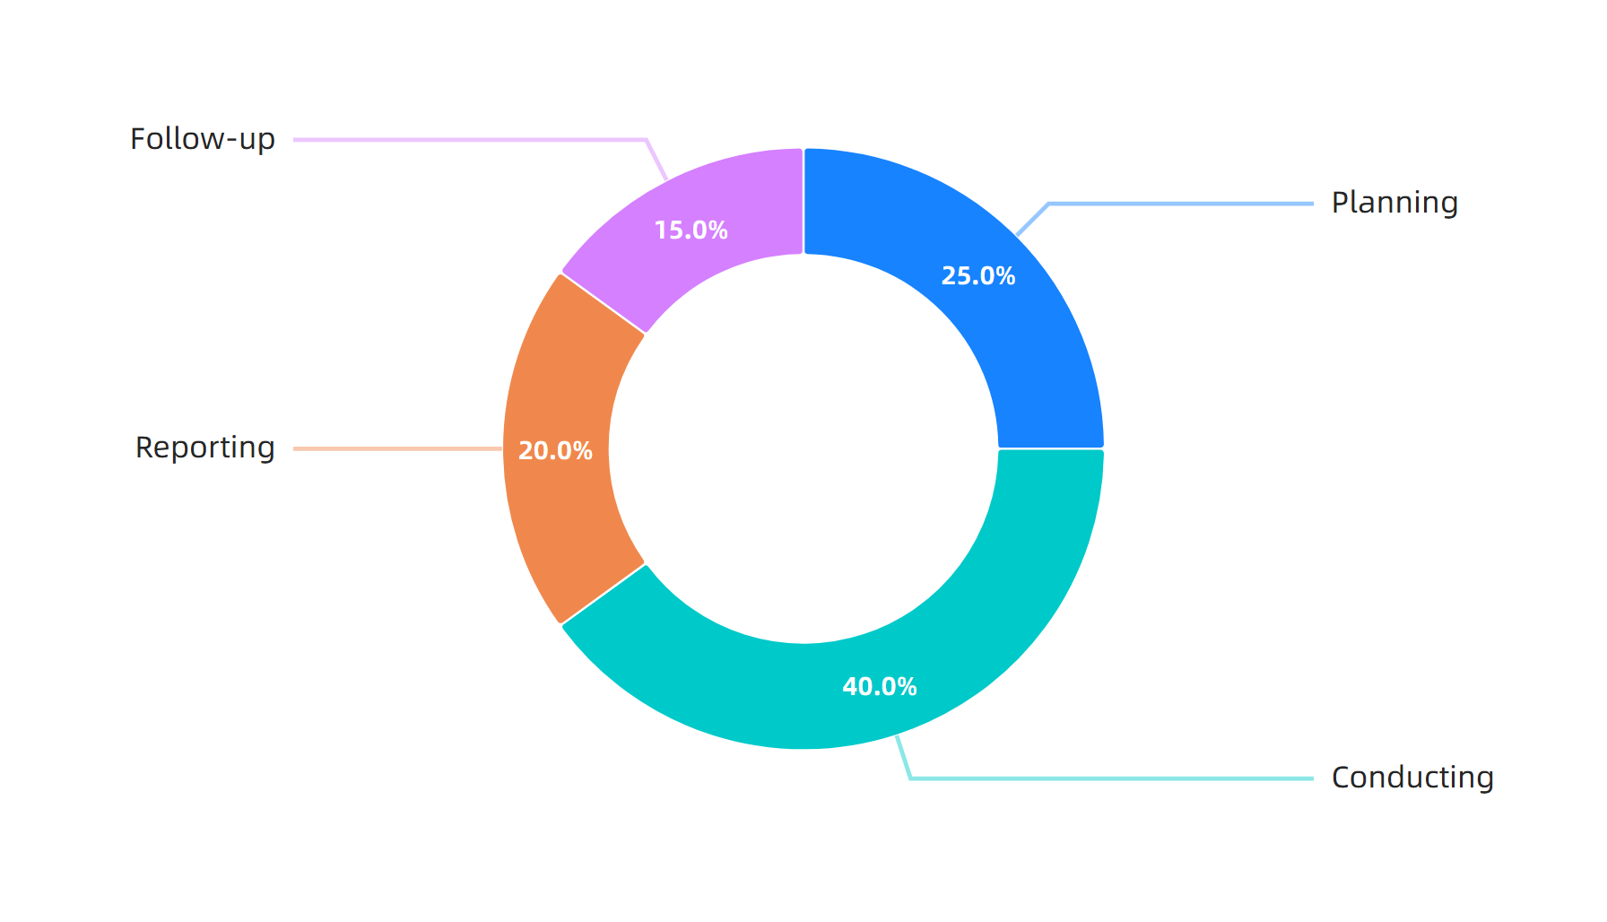
Audit Time Distribution
Source: ISO 14001:2015 Best Practice Guidelines
This material belongs to Tertiary Infotech Academy Pte Ltd (UEN: 201200696W). All Rights Reserved

Slide 17
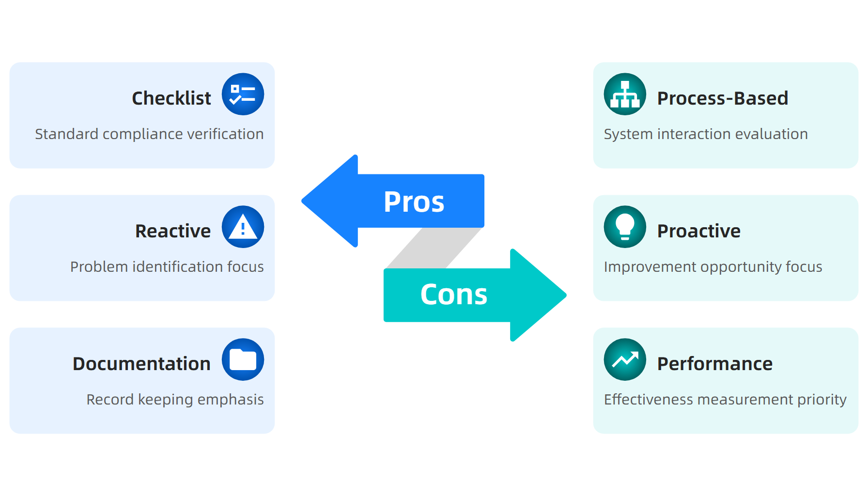
Traditional vs Modern Audit Approaches
Source: ISO 14001:2015 Implementation Guide, 2024
This material belongs to Tertiary Infotech Academy Pte Ltd (UEN: 201200696W). All Rights Reserved

Slide 18
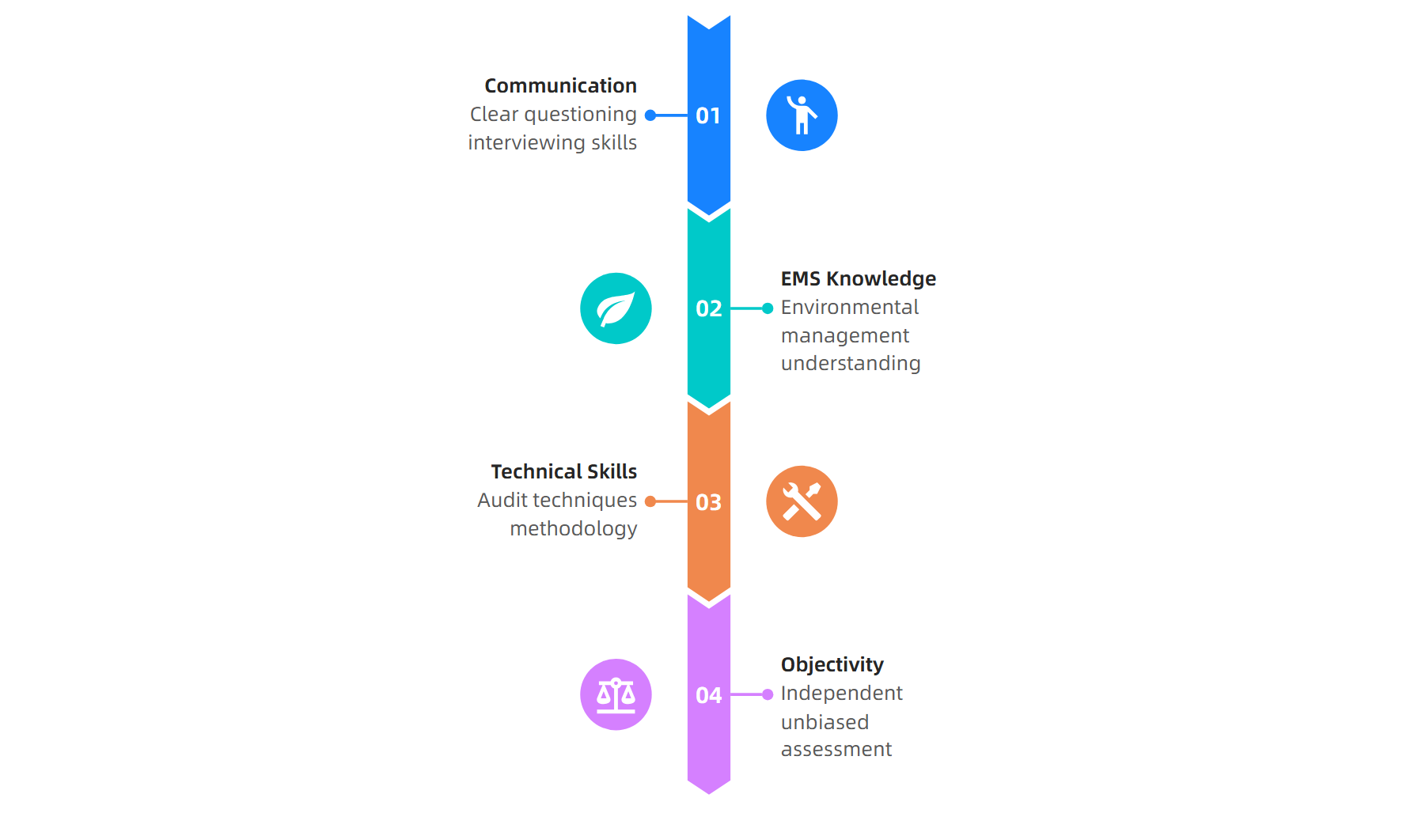
Auditor Competency Requirements
Source: NSF Internal Auditor Training, 2024
This material belongs to Tertiary Infotech Academy Pte Ltd (UEN: 201200696W). All Rights Reserved

Slide 19
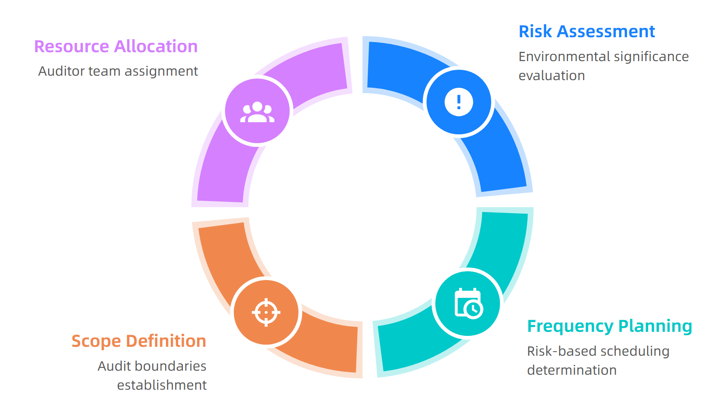
Risk-Based Audit Planning Cycle
Source: ISO 14001:2015 Audit Procedure Guide
This material belongs to Tertiary Infotech Academy Pte Ltd (UEN: 201200696W). All Rights Reserved

Slide 20
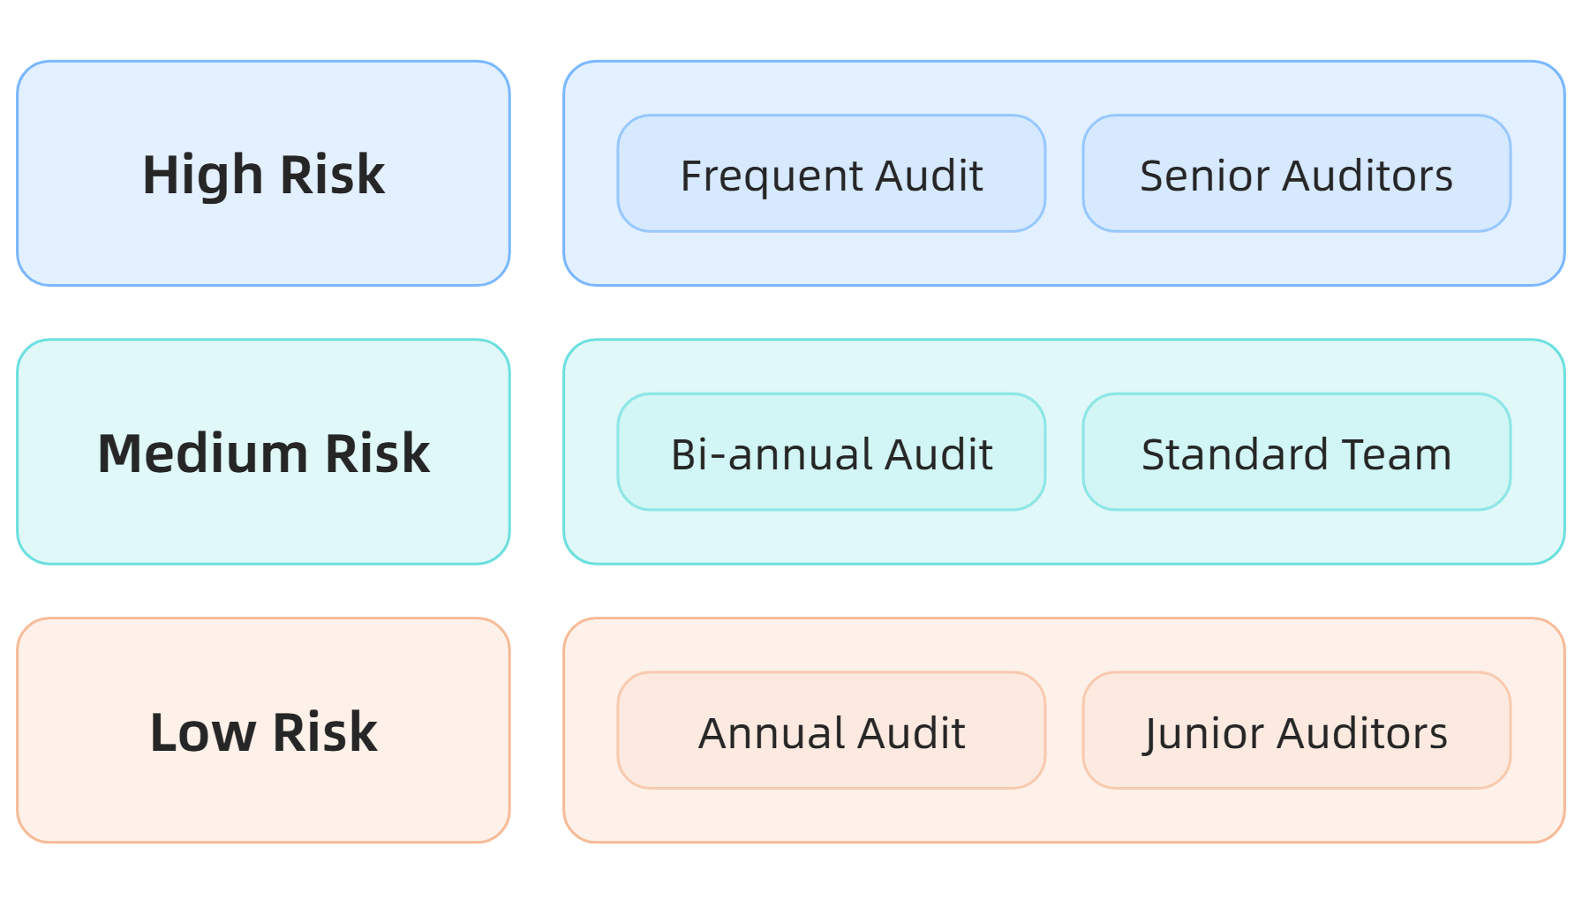
Environmental Aspects Significance Matrix
Source: ISO 14001:2015 Risk Management Guidelines
This material belongs to Tertiary Infotech Academy Pte Ltd (UEN: 201200696W). All Rights Reserved

Slide 21
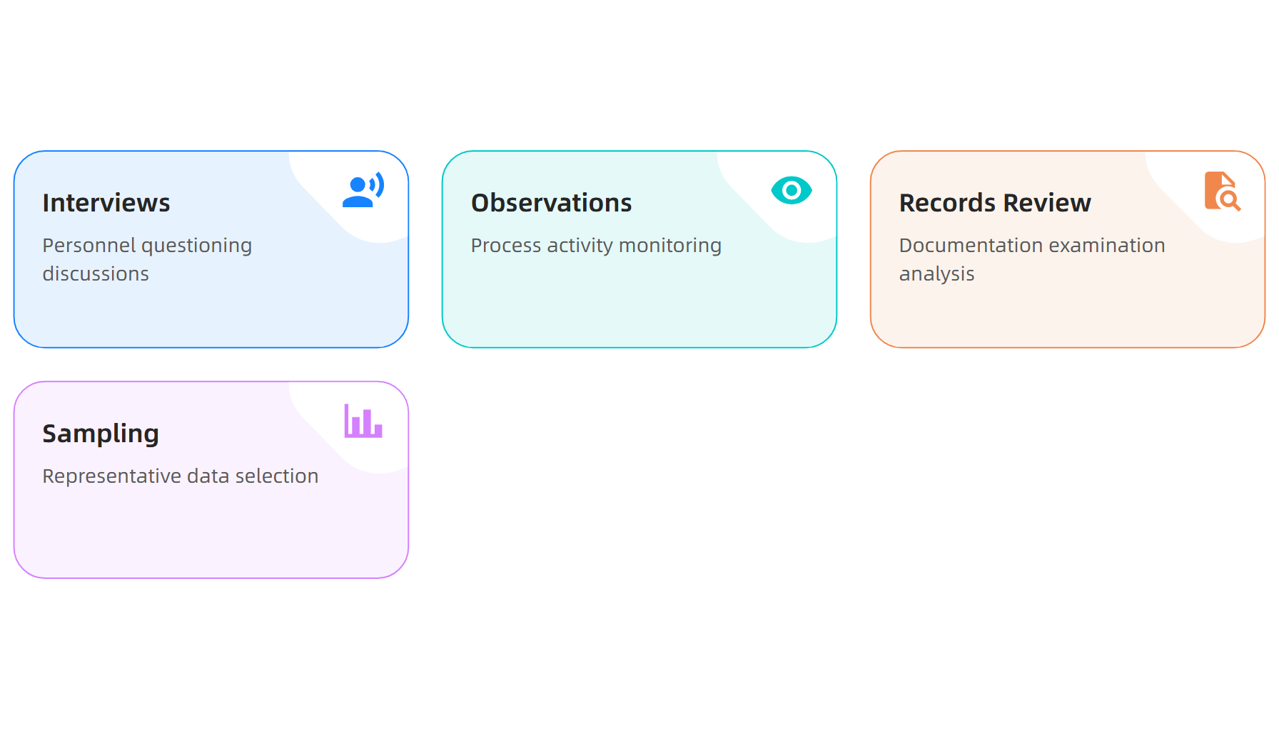
Audit Evidence Collection Methods
Source: ISO 14001:2015 Audit Guidelines
This material belongs to Tertiary Infotech Academy Pte Ltd (UEN: 201200696W). All Rights Reserved

Slide 22
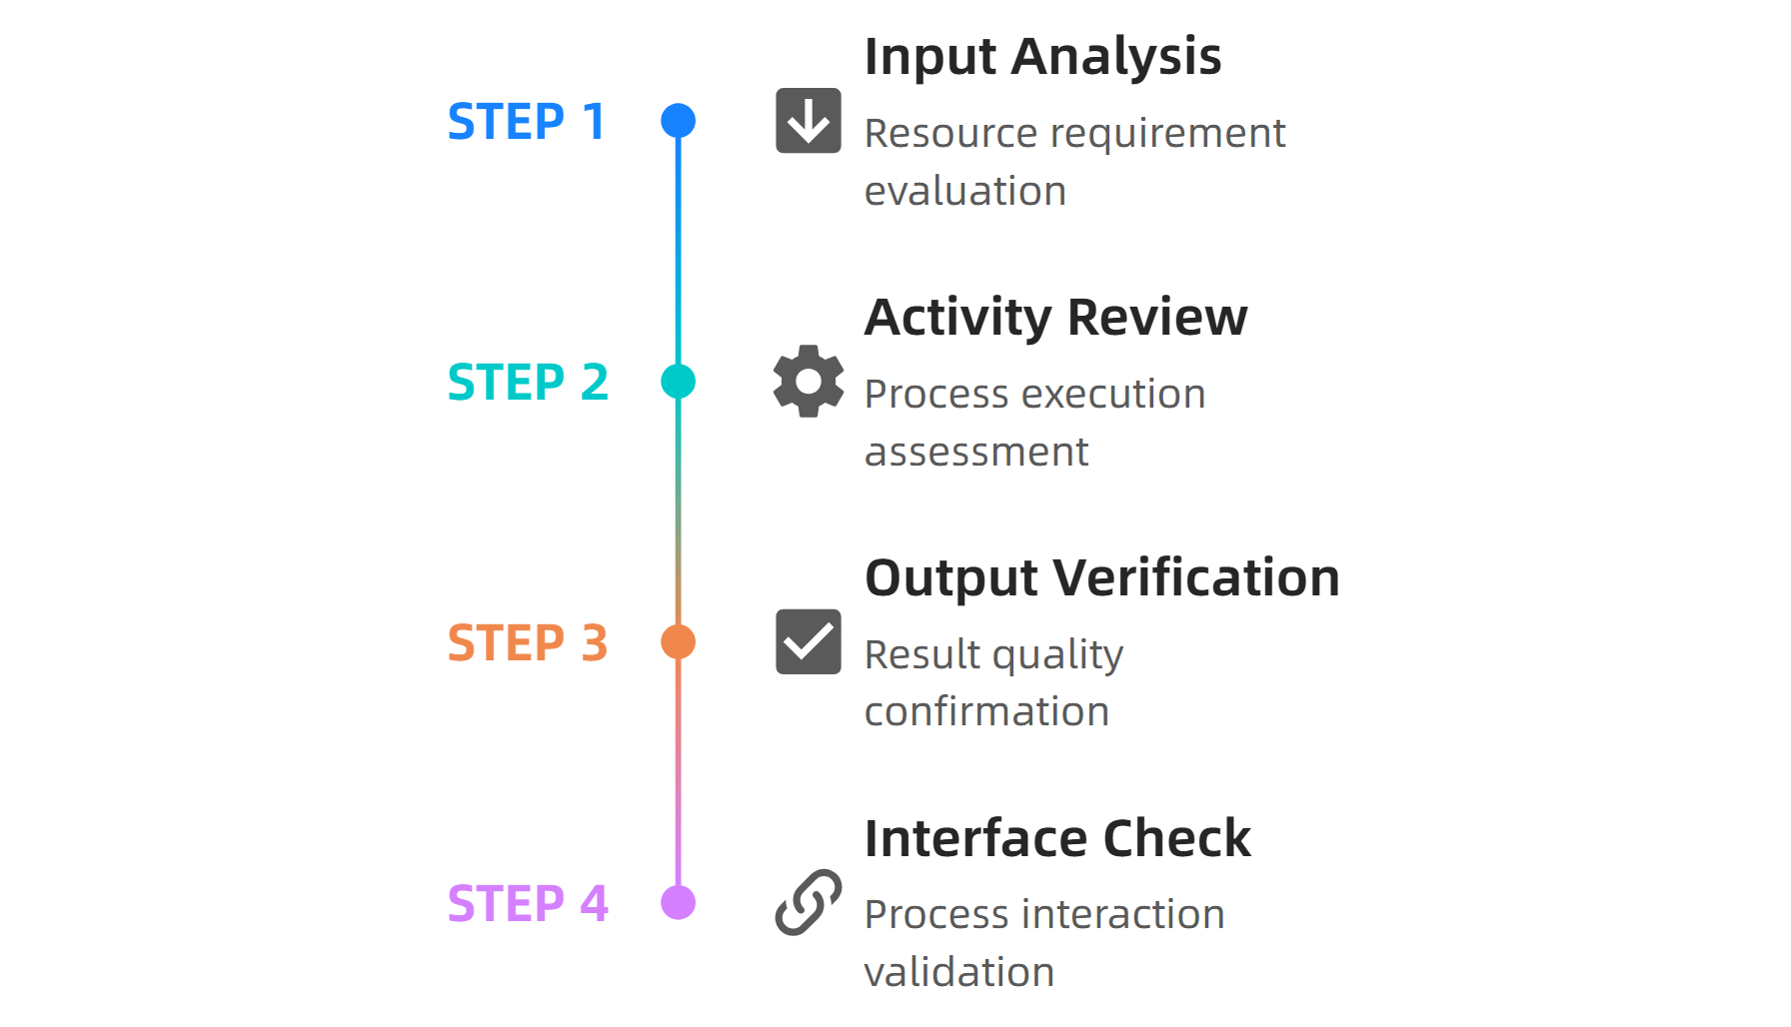
Process Audit Approach Timeline
Source: ISO 14001:2015 Process Audit Guide, 2024
This material belongs to Tertiary Infotech Academy Pte Ltd (UEN: 201200696W). All Rights Reserved

Slide 23
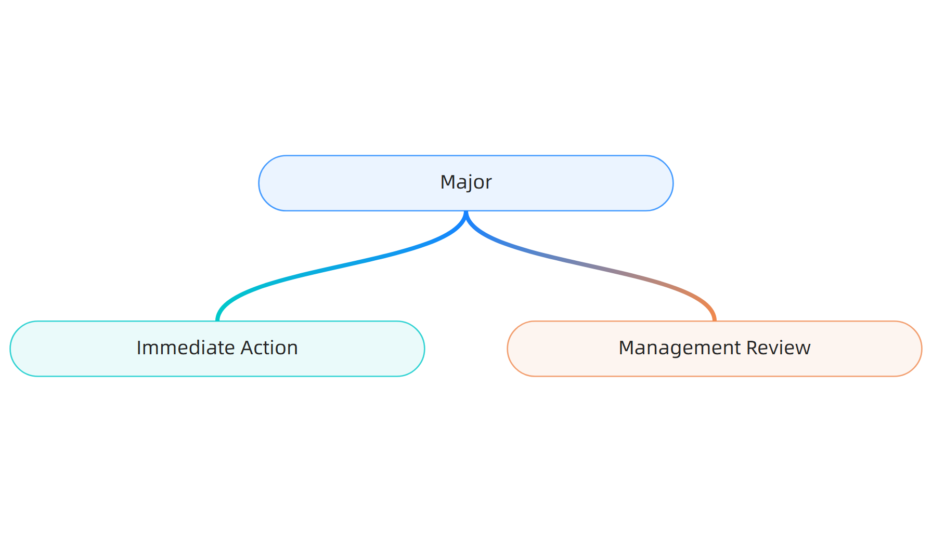
Nonconformity Classification System
Source: ISO 14001:2015 Audit Standards
This material belongs to Tertiary Infotech Academy Pte Ltd (UEN: 201200696W). All Rights Reserved

Slide 24
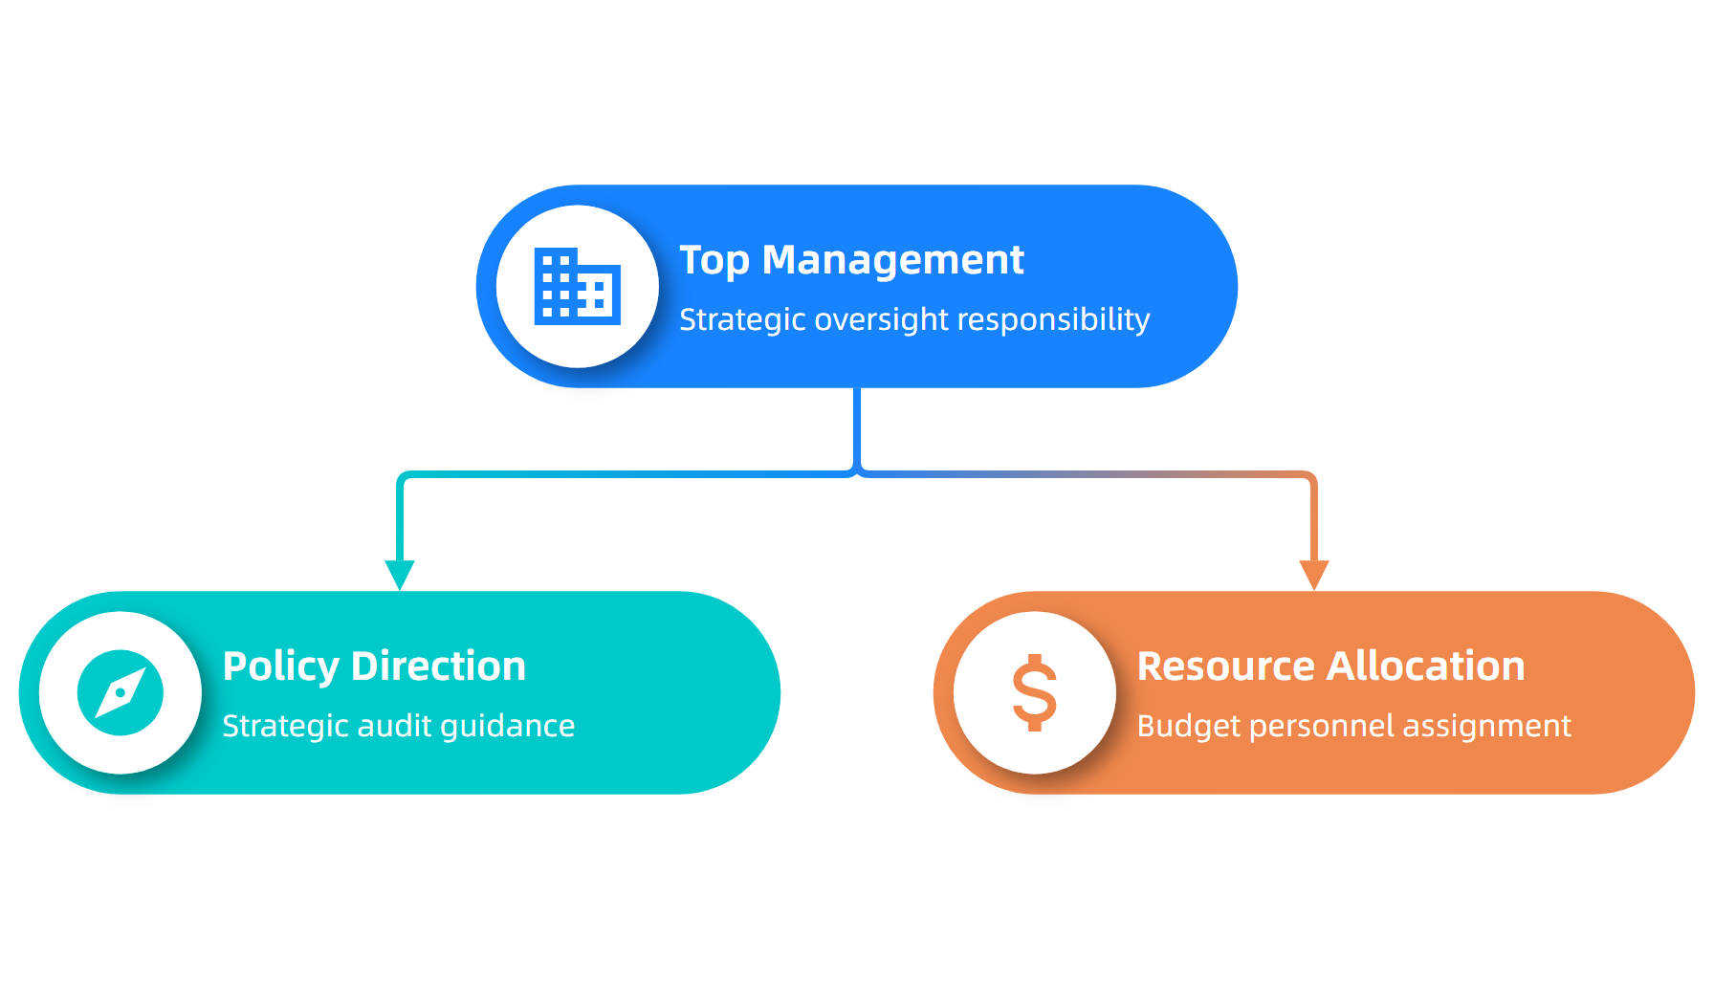
Audit Program Management Structure
Source: ISO 14001:2015 Management Guidelines
This material belongs to Tertiary Infotech Academy Pte Ltd (UEN: 201200696W). All Rights Reserved

Slide 25
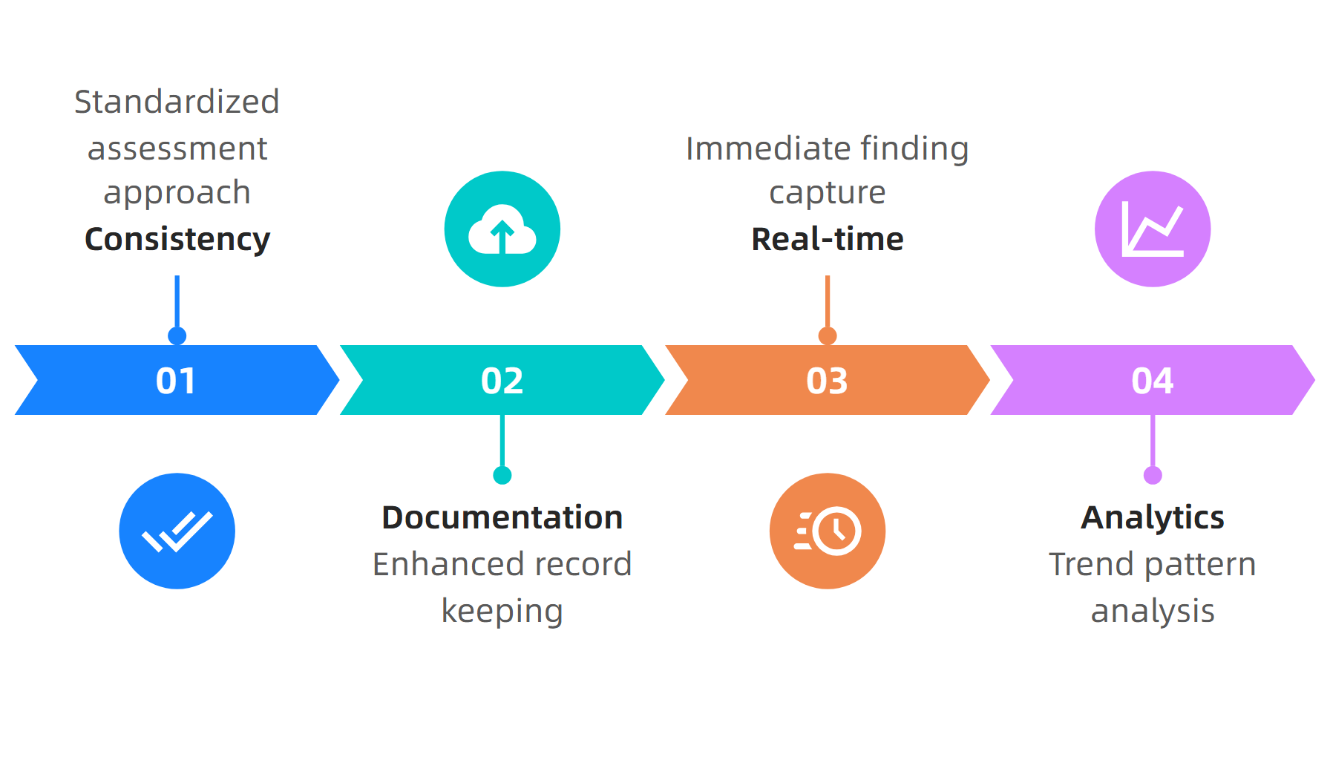
Digital Audit Tools Benefits
Source: SafetyCulture Audit Platform, 2024
This material belongs to Tertiary Infotech Academy Pte Ltd (UEN: 201200696W). All Rights Reserved

Slide 26
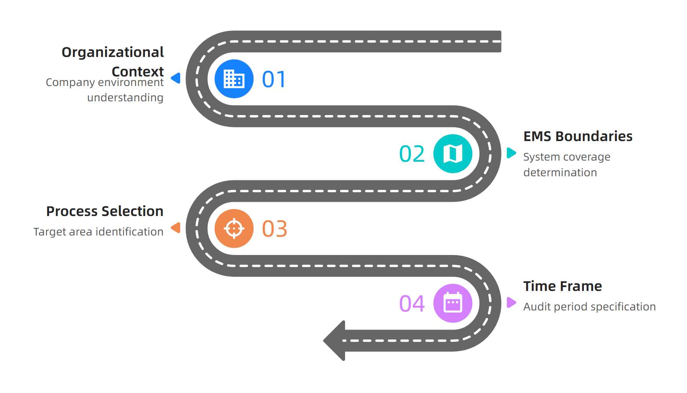
Audit Scope Definition Framework
Source: ISO 14001:2015 Audit Planning Guide
This material belongs to Tertiary Infotech Academy Pte Ltd (UEN: 201200696W). All Rights Reserved

Slide 27
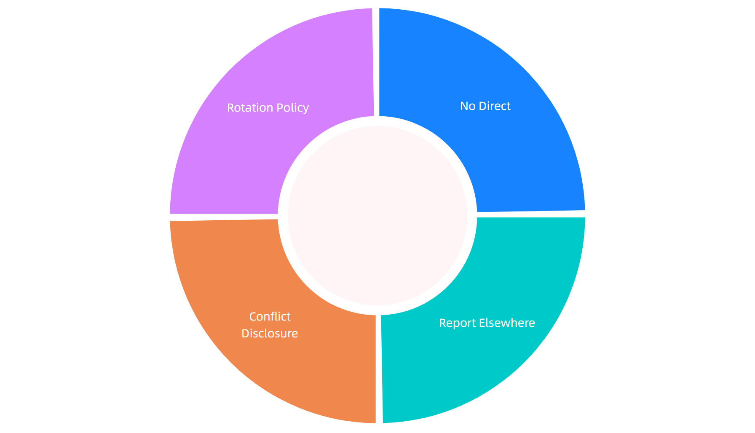
Auditor Independence Requirements
Source: NSF Independence Guidelines, 2024
This material belongs to Tertiary Infotech Academy Pte Ltd (UEN: 201200696W). All Rights Reserved

Slide 28
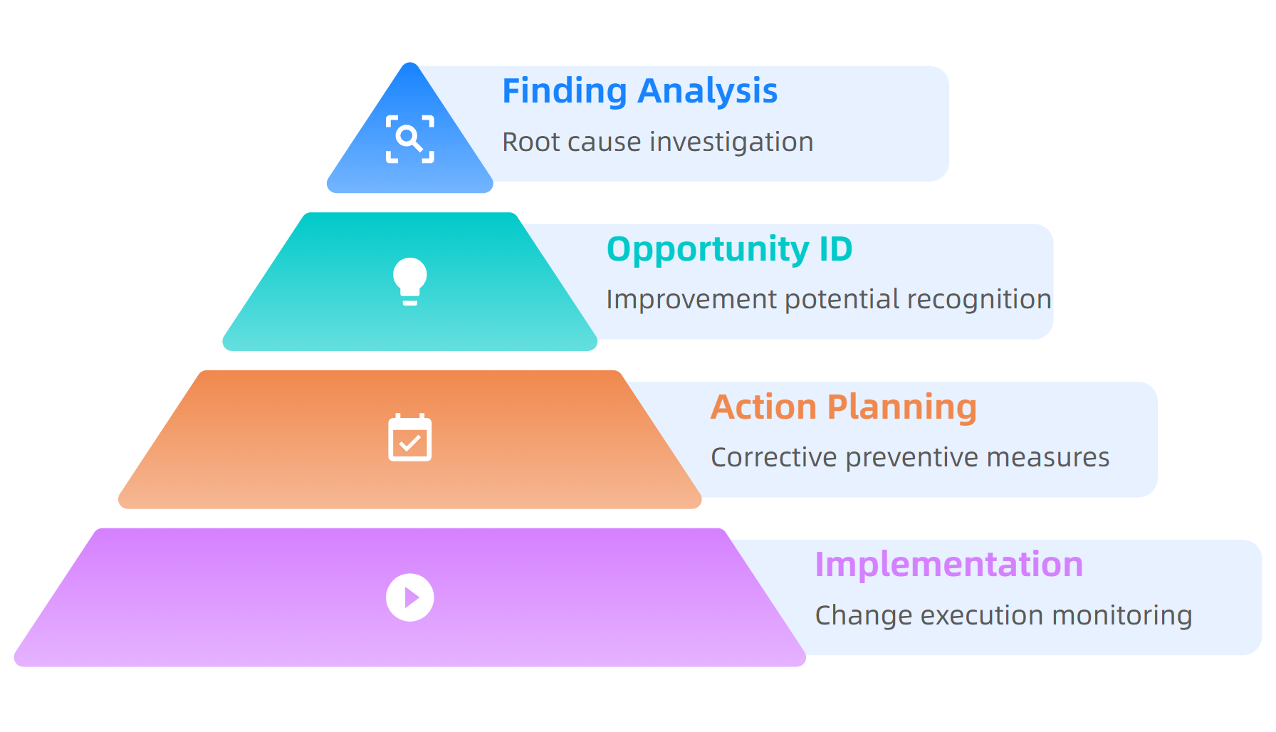
Continuous Improvement Integration
Source: ISO 14001:2015 Improvement Guide, 2024
This material belongs to Tertiary Infotech Academy Pte Ltd (UEN: 201200696W). All Rights Reserved

Slide 29
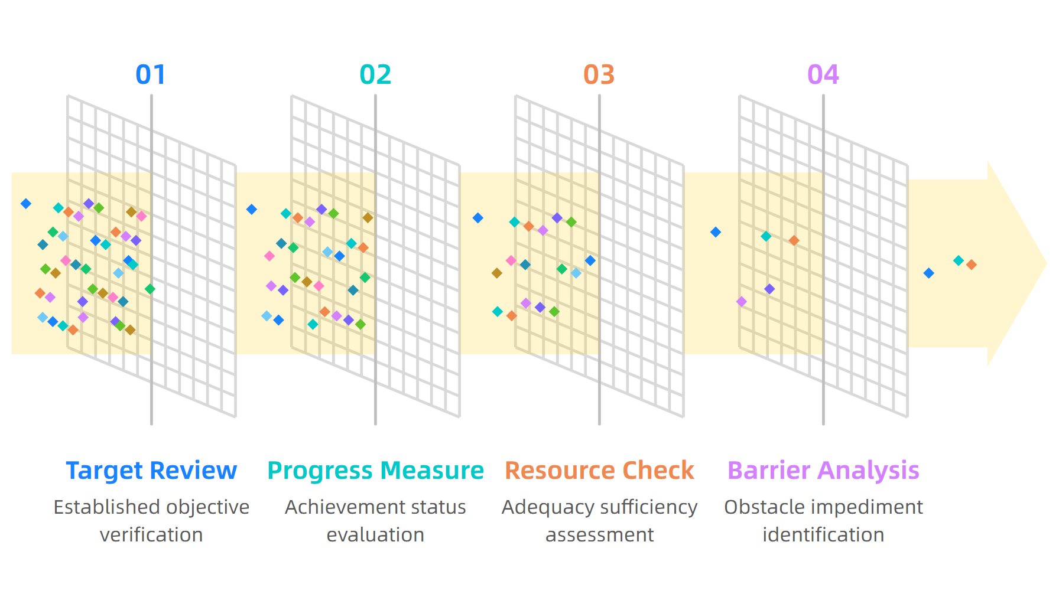
Environmental Objectives Assessment
Source: ISO 14001:2015 Objectives Guidelines
This material belongs to Tertiary Infotech Academy Pte Ltd (UEN: 201200696W). All Rights Reserved

Slide 30
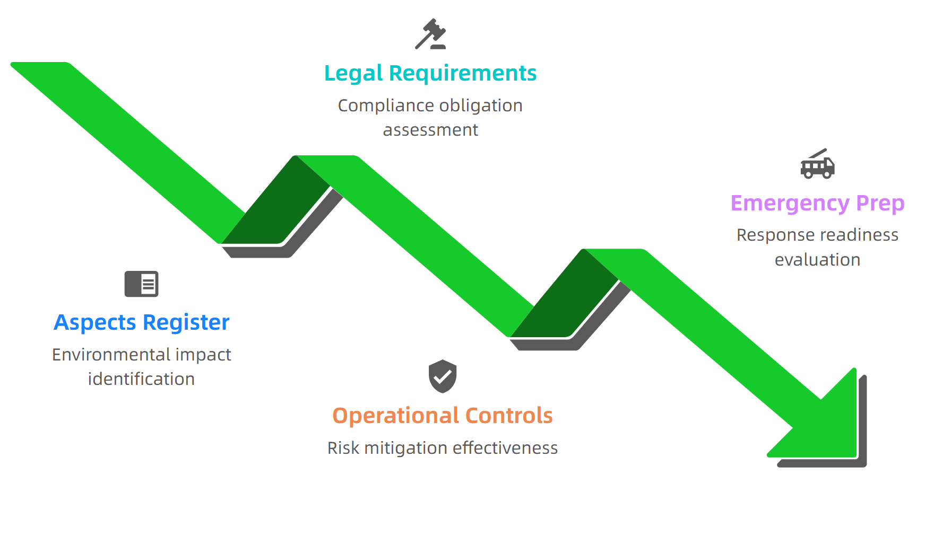
Risk Assessment Integration Points
Source: ISO 14001:2015 Risk Management Standards
This material belongs to Tertiary Infotech Academy Pte Ltd (UEN: 201200696W). All Rights Reserved

Slide 31
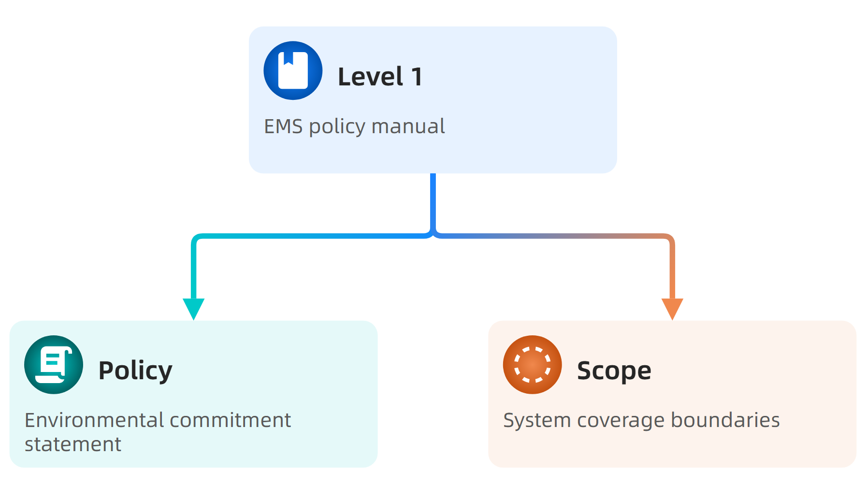
Documentation Requirements Hierarchy
Source: ISO 14001:2015 Documentation Standards
This material belongs to Tertiary Infotech Academy Pte Ltd (UEN: 201200696W). All Rights Reserved

Slide 32
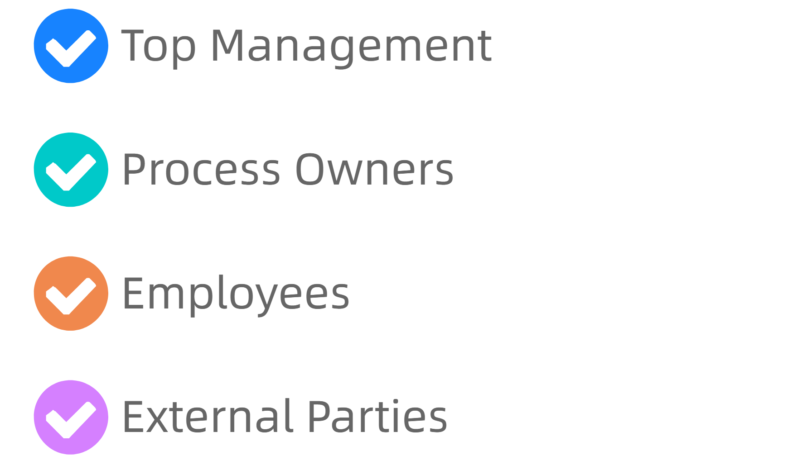
Stakeholder Communication Strategy
Source: ISO 14001:2015 Communication Guidelines
This material belongs to Tertiary Infotech Academy Pte Ltd (UEN: 201200696W). All Rights Reserved

Slide 33
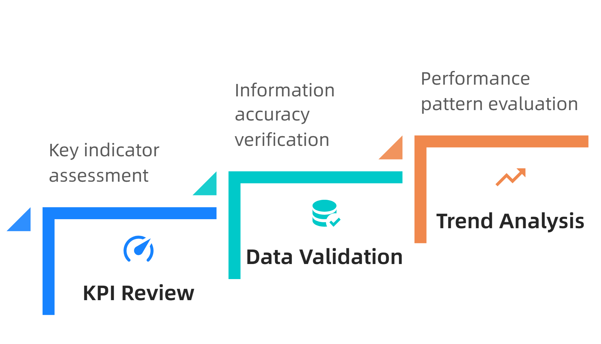
Performance Monitoring Integration
Source: ISO 14001:2015 Performance Guidelines
This material belongs to Tertiary Infotech Academy Pte Ltd (UEN: 201200696W). All Rights Reserved

Slide 34
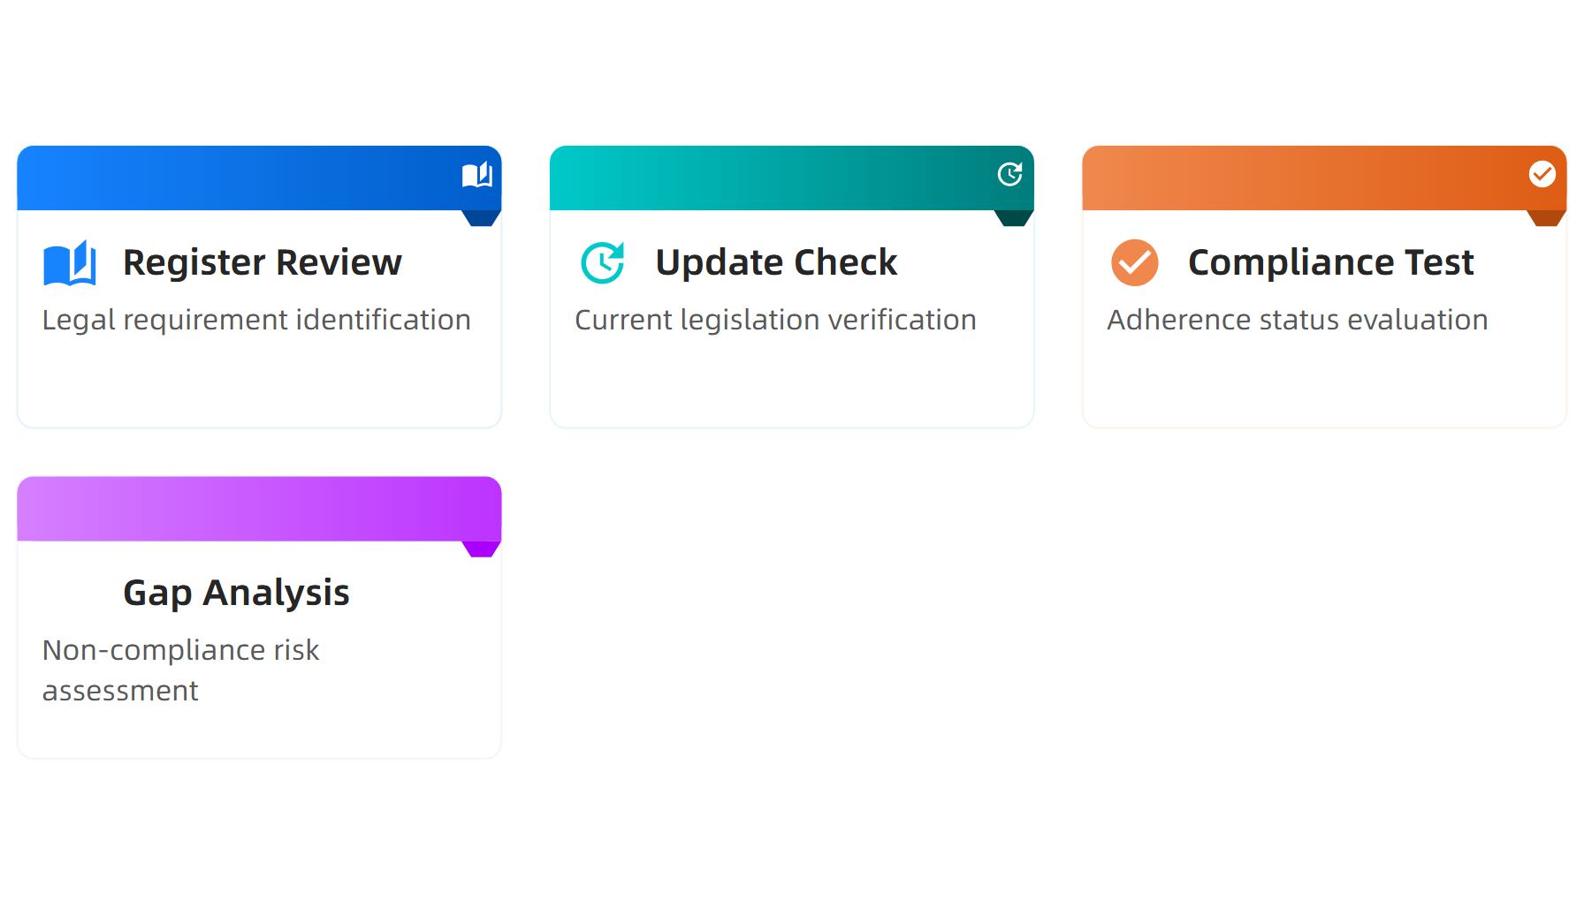
Legal Compliance Verification Framework
Source: ISO 14001:2015 Legal Compliance Guide
This material belongs to Tertiary Infotech Academy Pte Ltd (UEN: 201200696W). All Rights Reserved

Slide 35
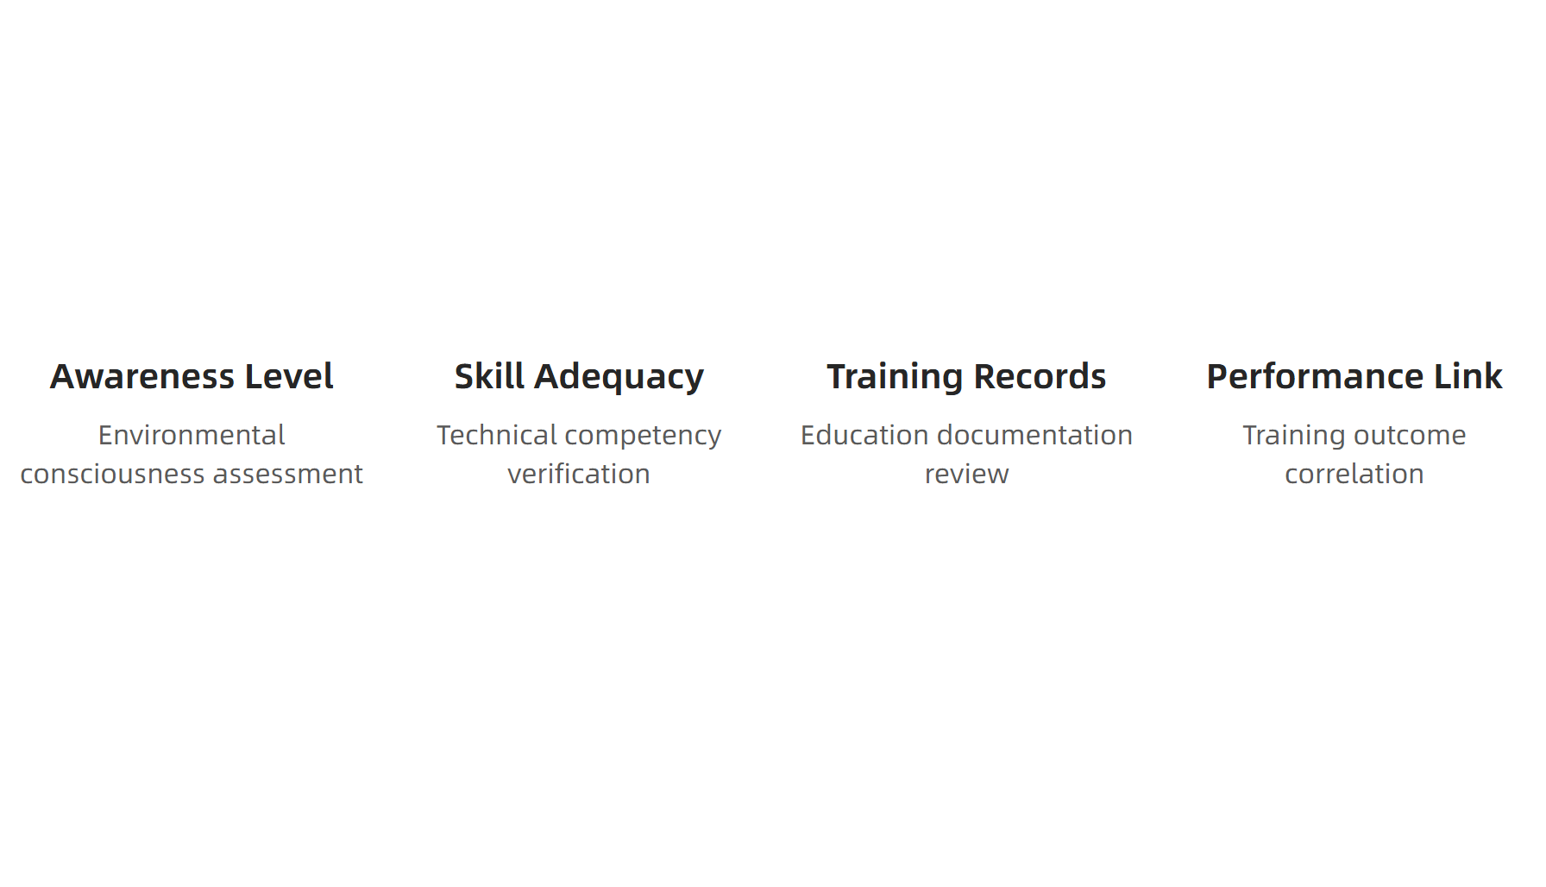
Training and Competence Audit Areas
Source: ISO 14001:2015 Competence Standards
This material belongs to Tertiary Infotech Academy Pte Ltd (UEN: 201200696W). All Rights Reserved

Slide 36
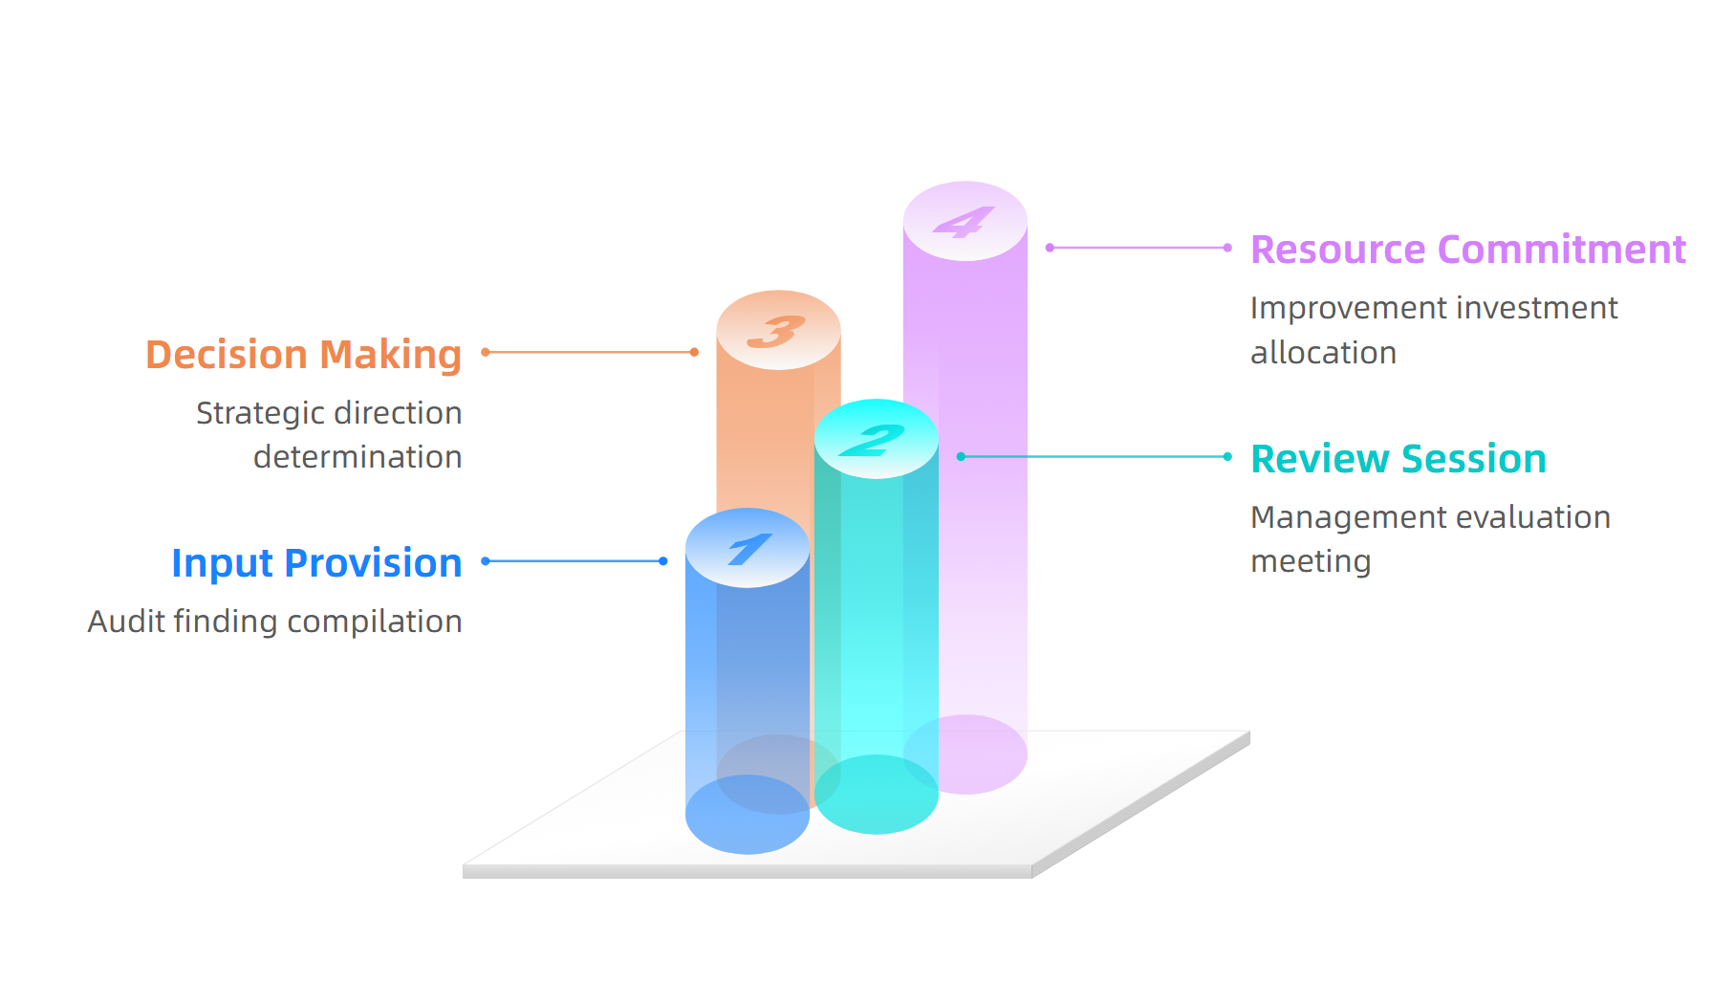
Management Review Integration
Source: ISO 14001:2015 Management Review Guidelines
This material belongs to Tertiary Infotech Academy Pte Ltd (UEN: 201200696W). All Rights Reserved

Slide 37
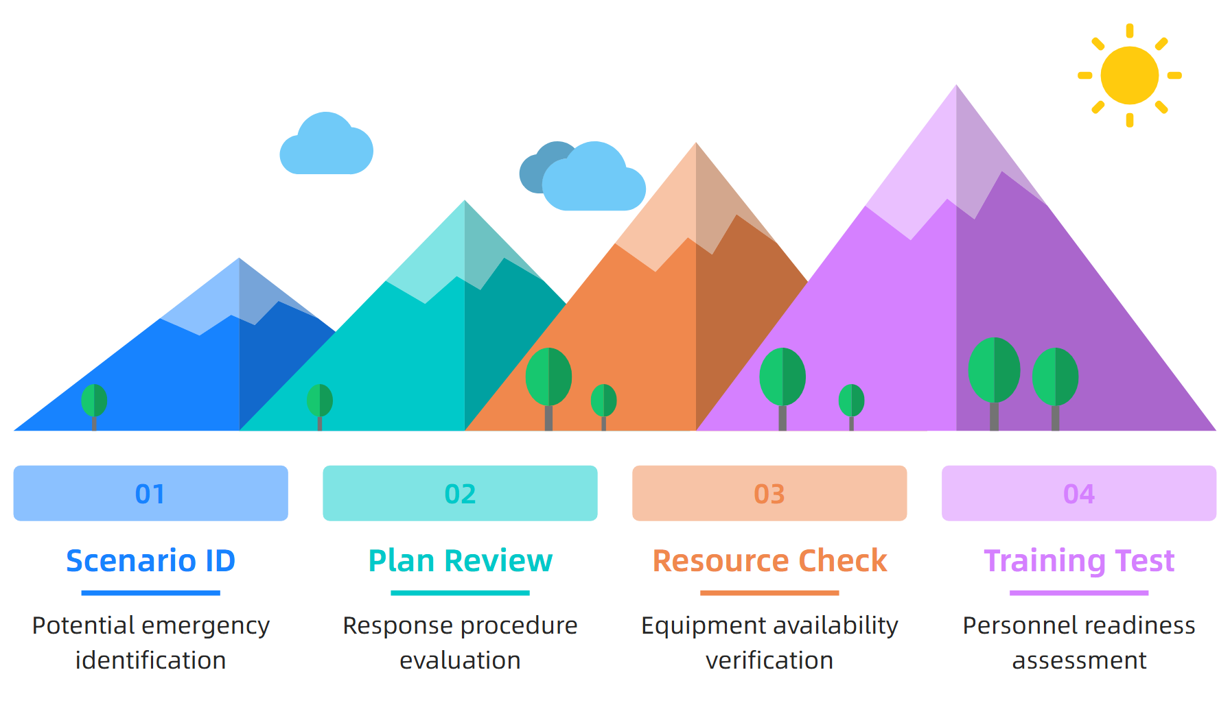
Emergency Preparedness Audit
Source: ISO 14001:2015 Emergency Preparedness Guide
This material belongs to Tertiary Infotech Academy Pte Ltd (UEN: 201200696W). All Rights Reserved

Slide 38
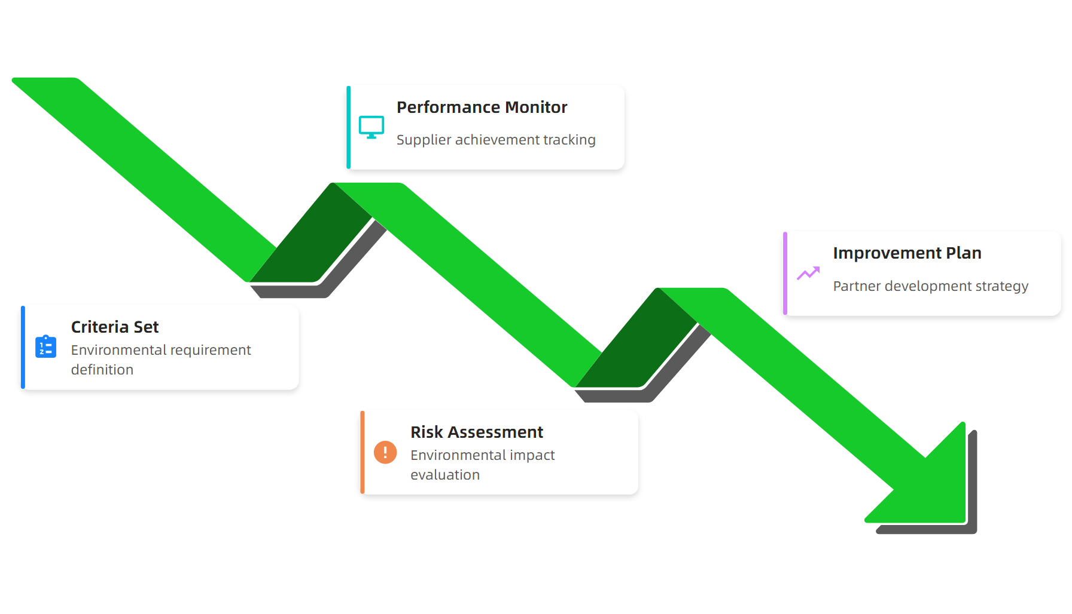
Supplier Environmental Assessment
Source: ISO 14001:2015 Supplier Management Guidelines
This material belongs to Tertiary Infotech Academy Pte Ltd (UEN: 201200696W). All Rights Reserved

Slide 39
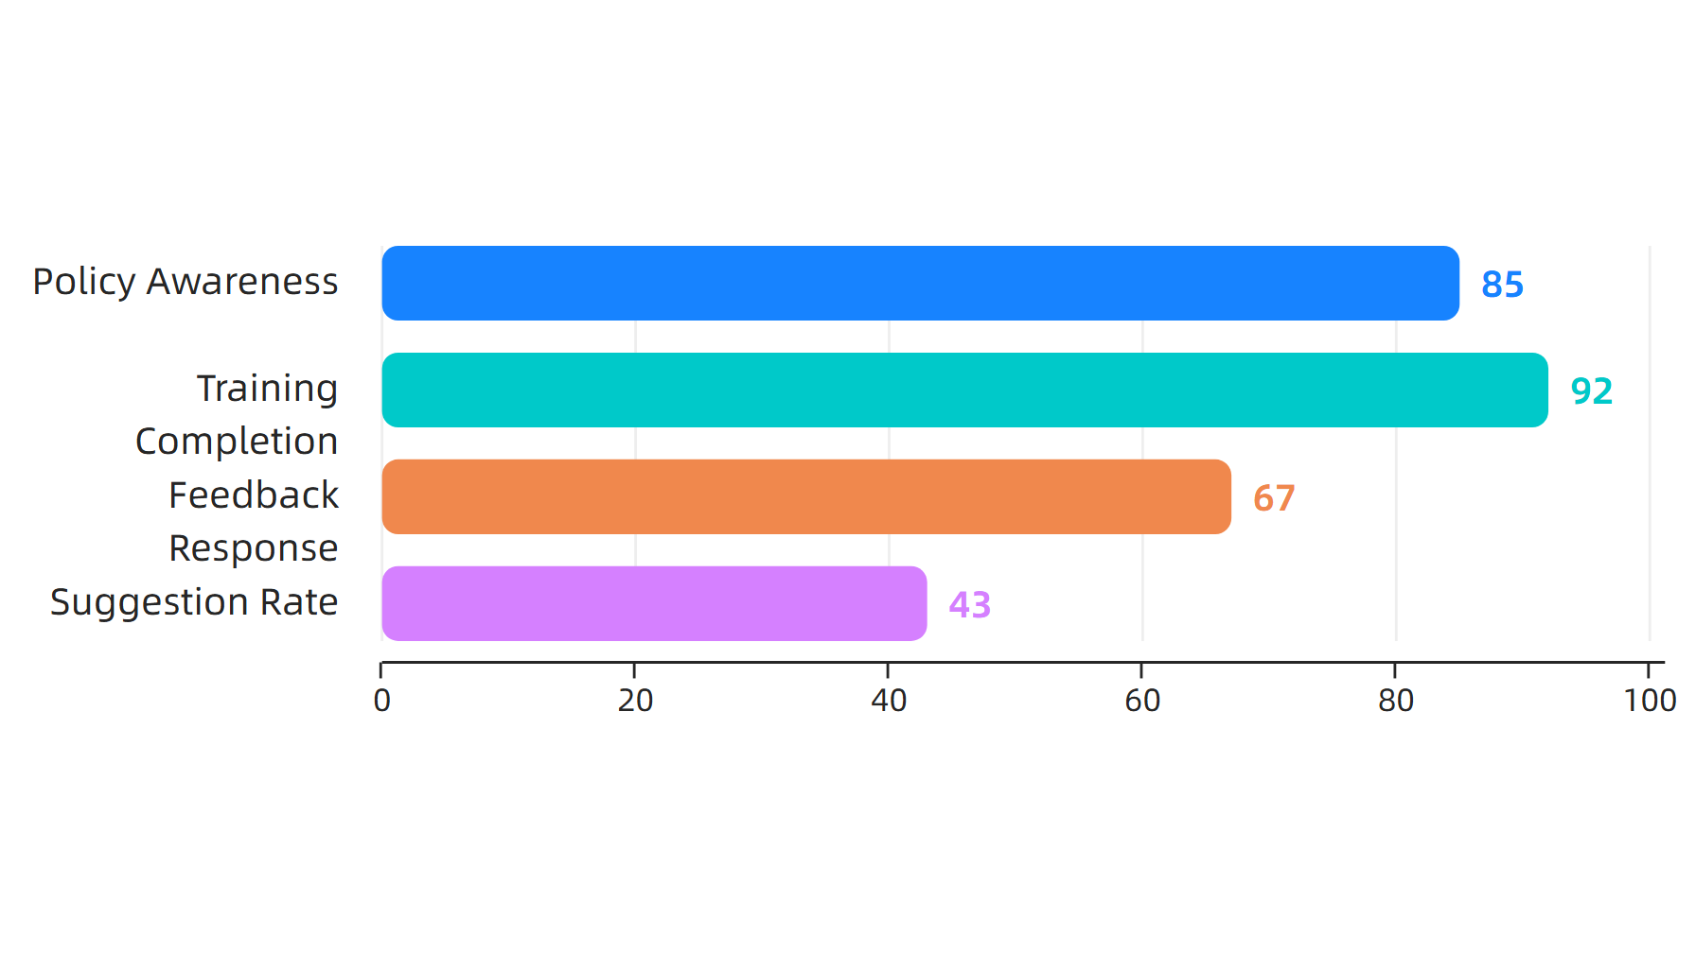
Internal Communication Effectiveness
Source: ISO 14001:2015 Communication Benchmarks
This material belongs to Tertiary Infotech Academy Pte Ltd (UEN: 201200696W). All Rights Reserved

Slide 40
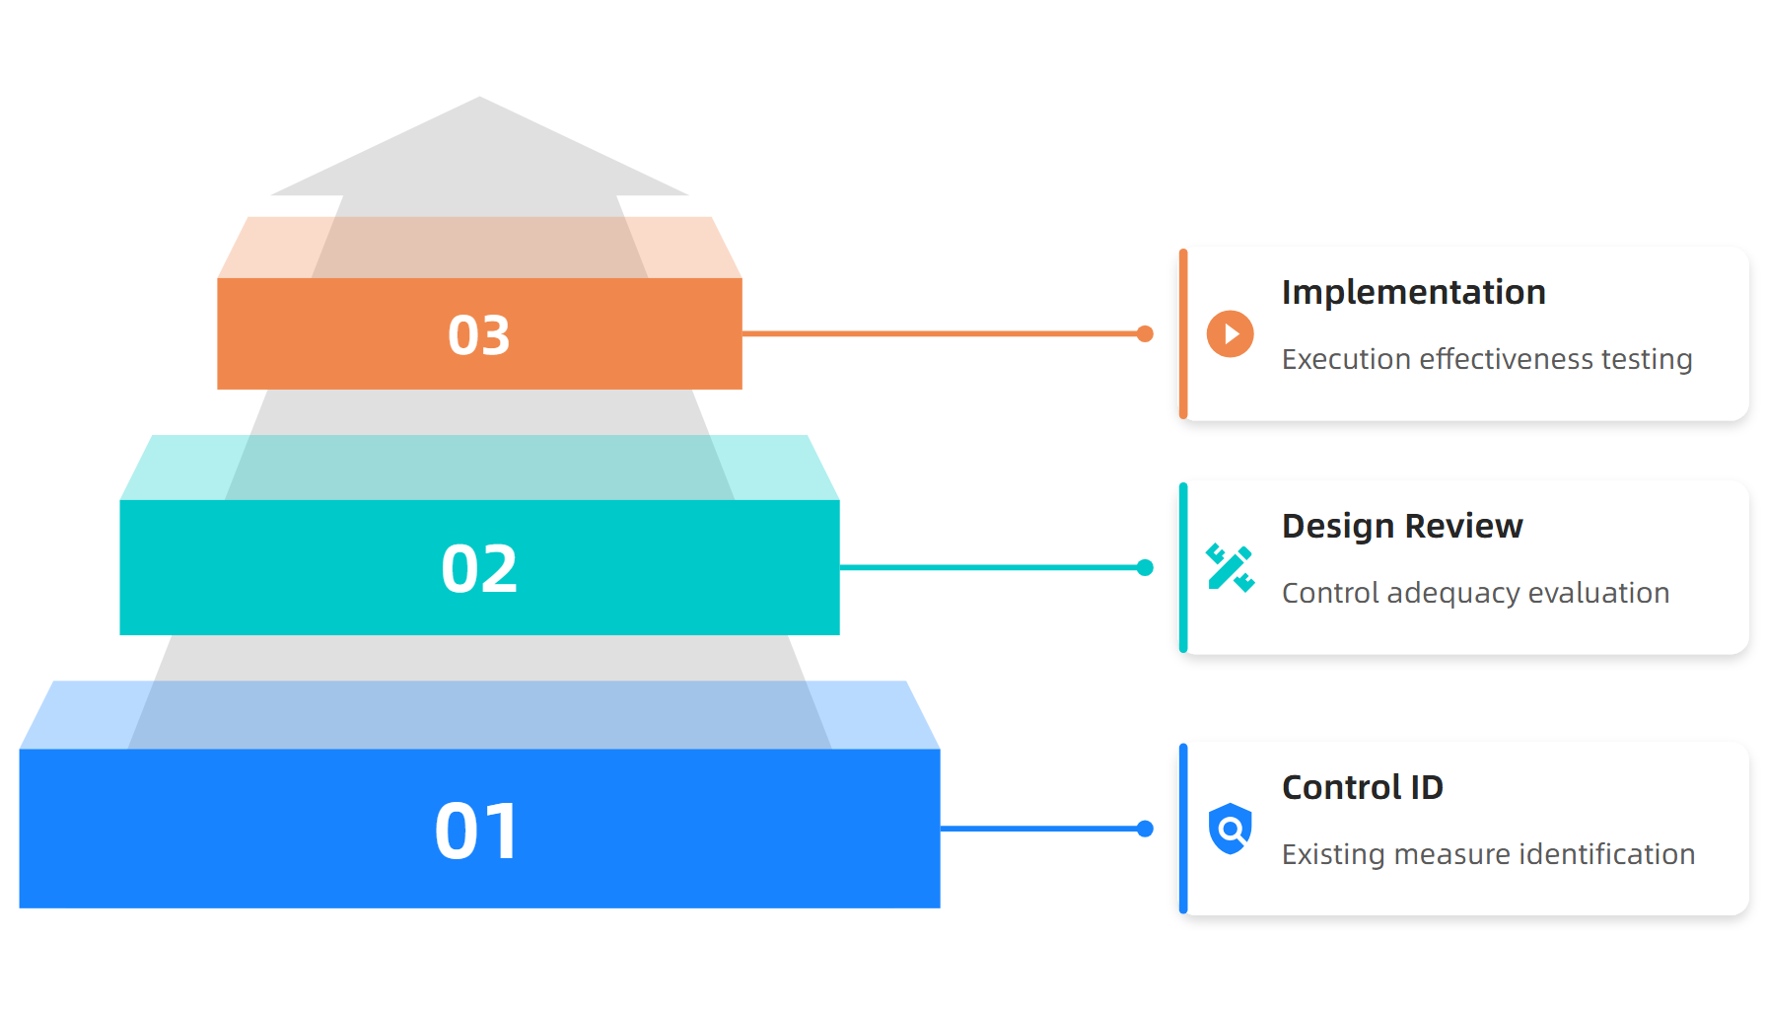
Operational Control Verification
Source: ISO 14001:2015 Operational Control Guidelines
This material belongs to Tertiary Infotech Academy Pte Ltd (UEN: 201200696W). All Rights Reserved

Slide 41
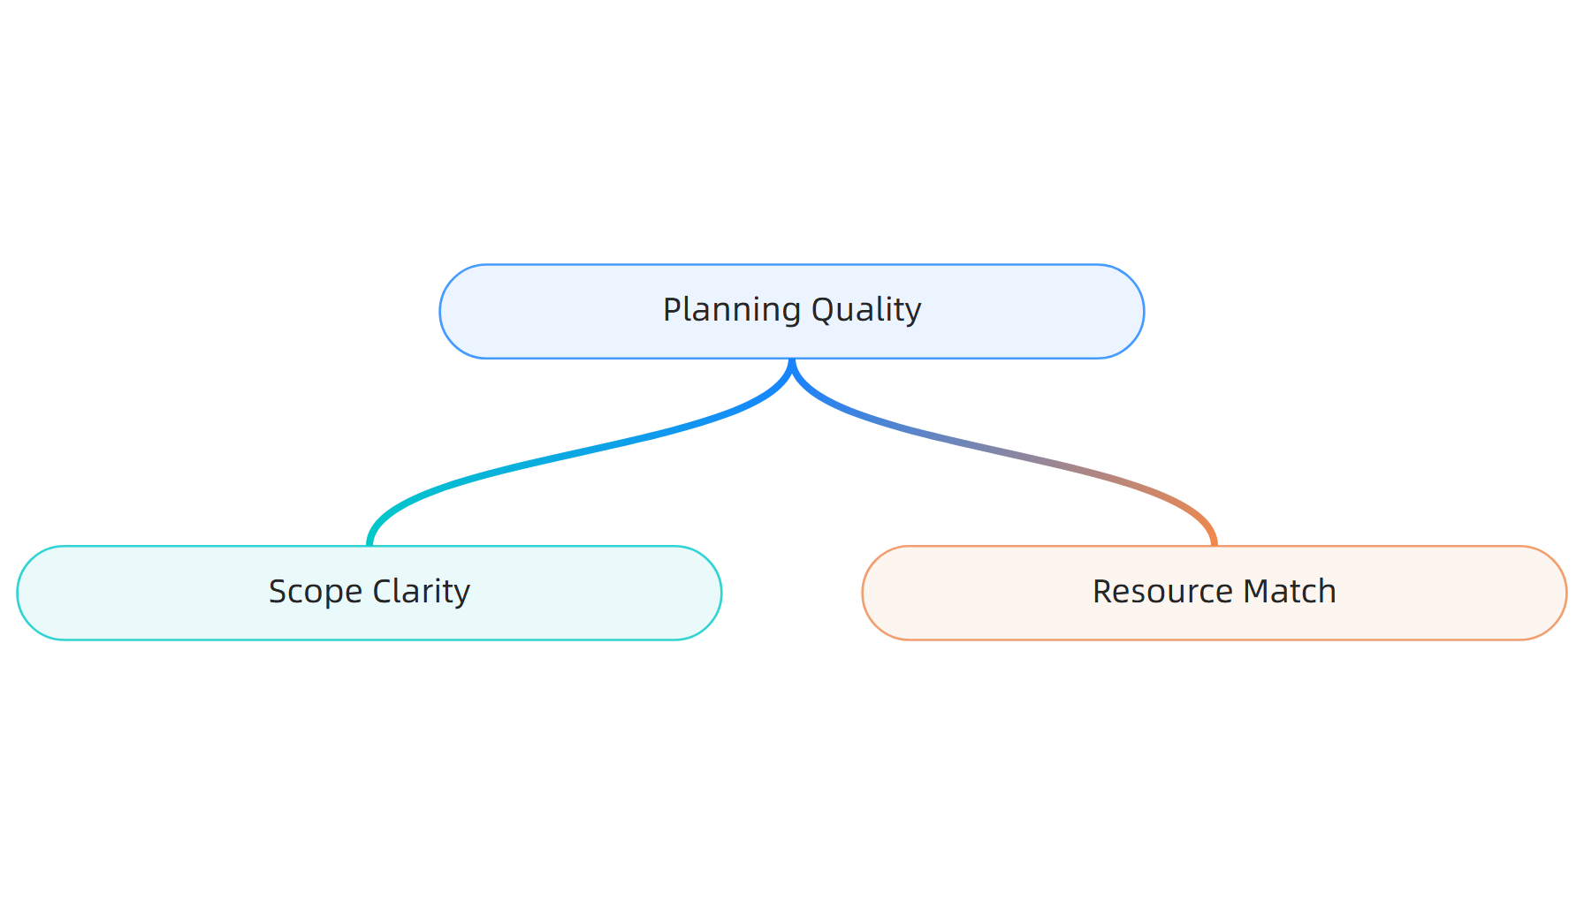
Audit Quality Assurance Framework
Source: ISO 14001:2015 Quality Standards
This material belongs to Tertiary Infotech Academy Pte Ltd (UEN: 201200696W). All Rights Reserved

Slide 42
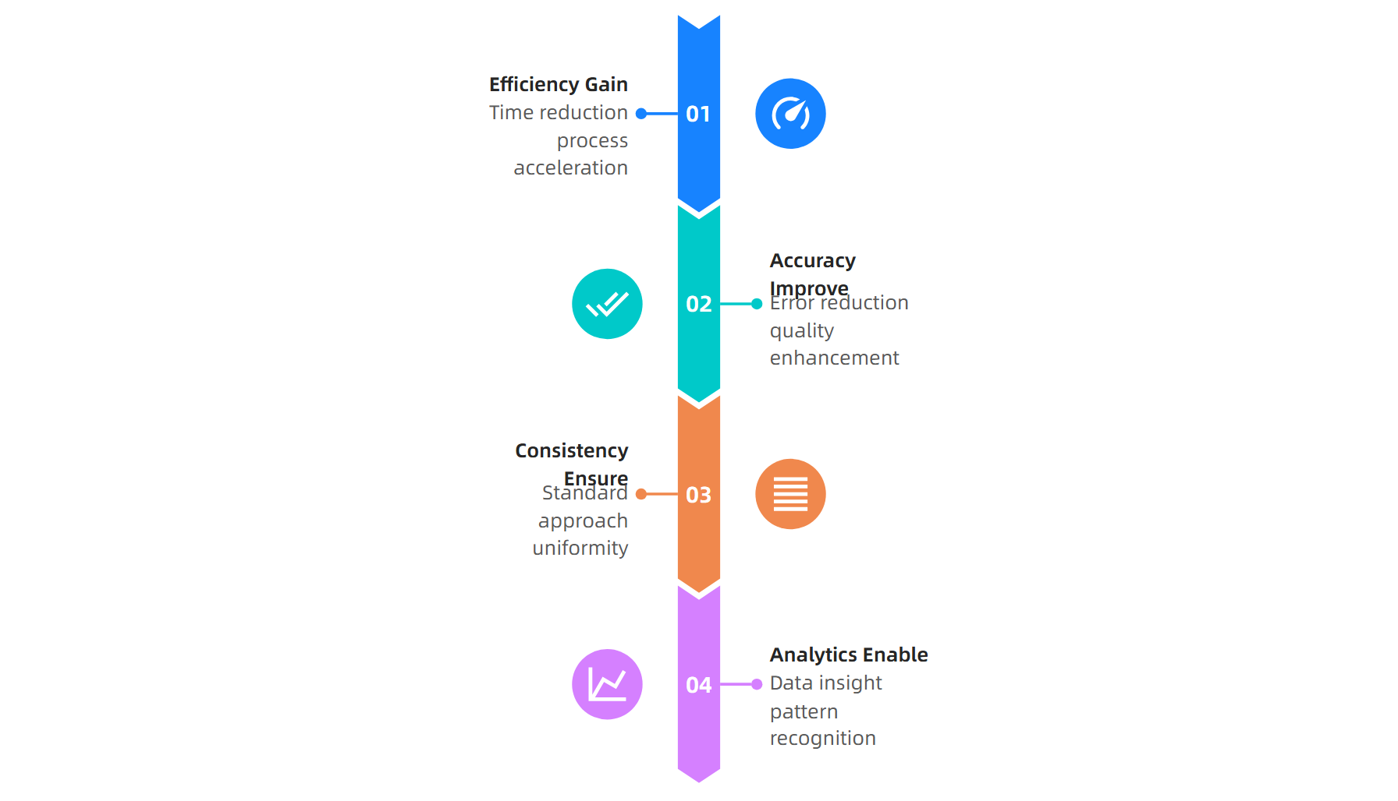
Technology Integration Benefits
Source: SafetyCulture Technology Guide, 2024
This material belongs to Tertiary Infotech Academy Pte Ltd (UEN: 201200696W). All Rights Reserved

Slide 43
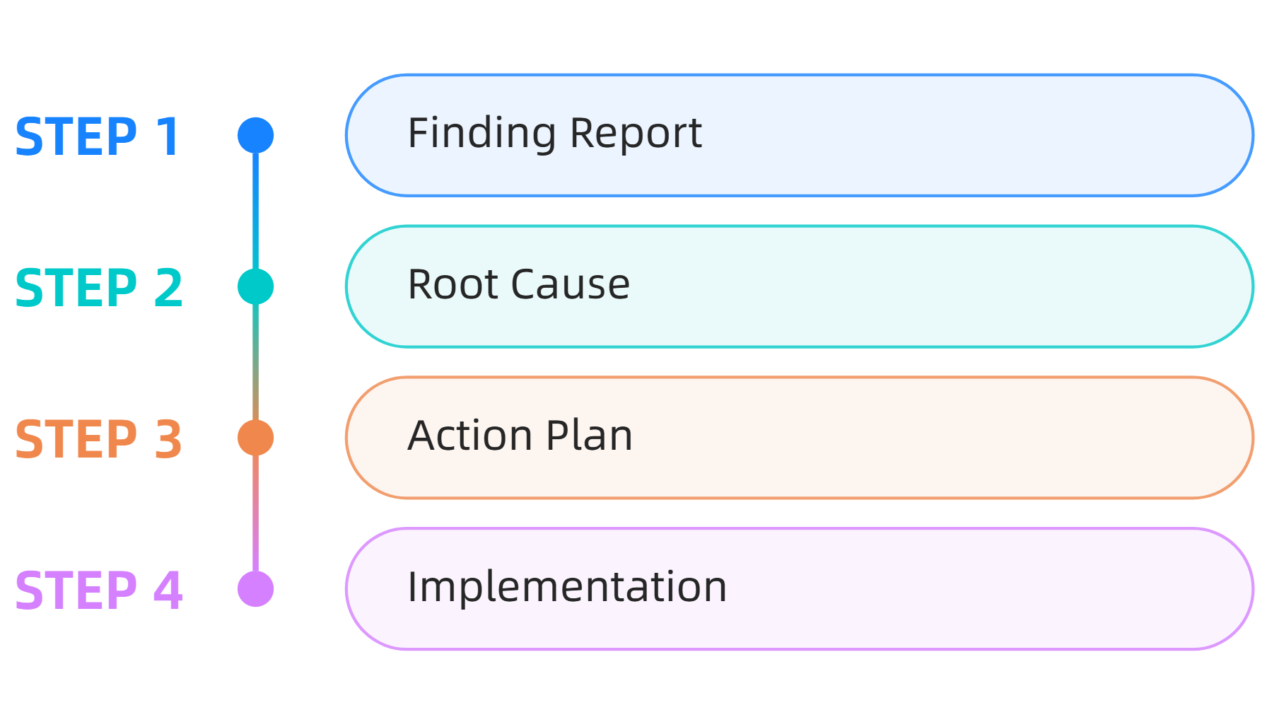
Corrective Action Tracking System
Source: ISO 14001:2015 Corrective Action Guide
This material belongs to Tertiary Infotech Academy Pte Ltd (UEN: 201200696W). All Rights Reserved

Slide 44
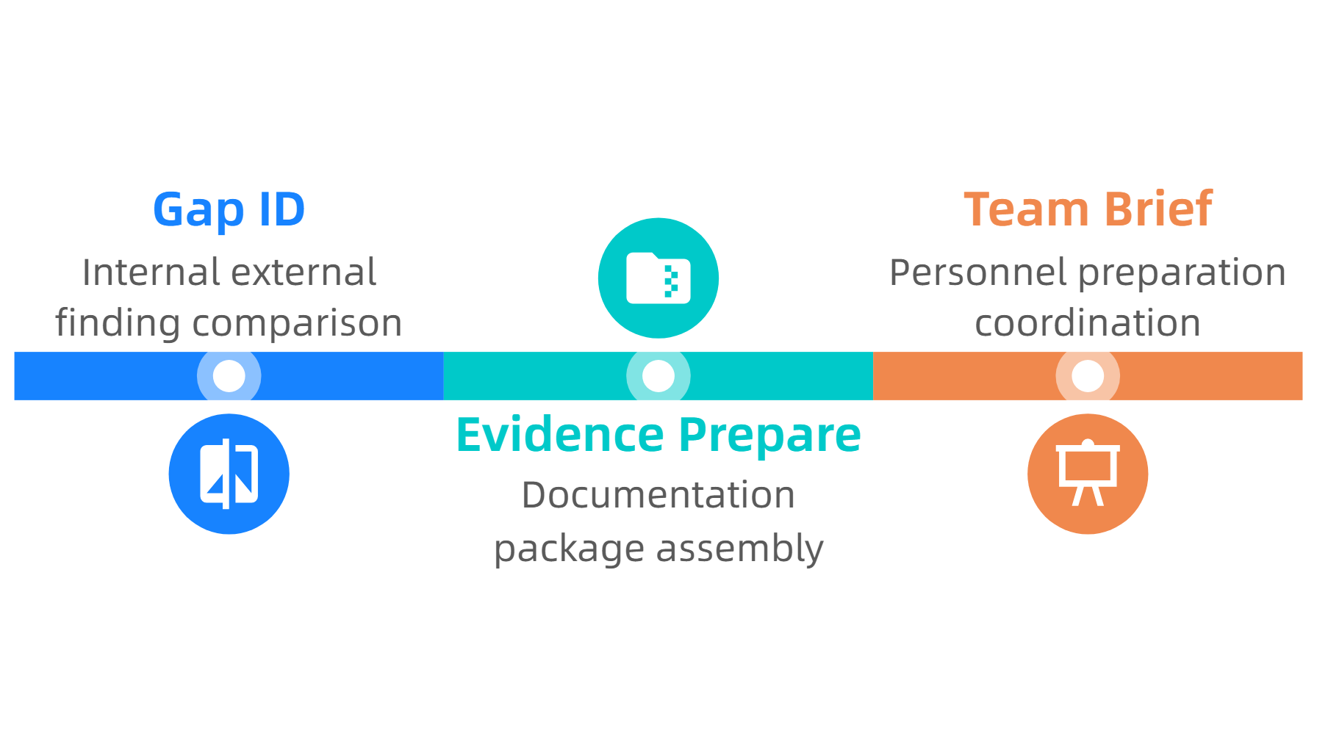
External Audit Preparation Integration
Source: ISO 14001:2015 Certification Preparation Guide
This material belongs to Tertiary Infotech Academy Pte Ltd (UEN: 201200696W). All Rights Reserved

Slide 45
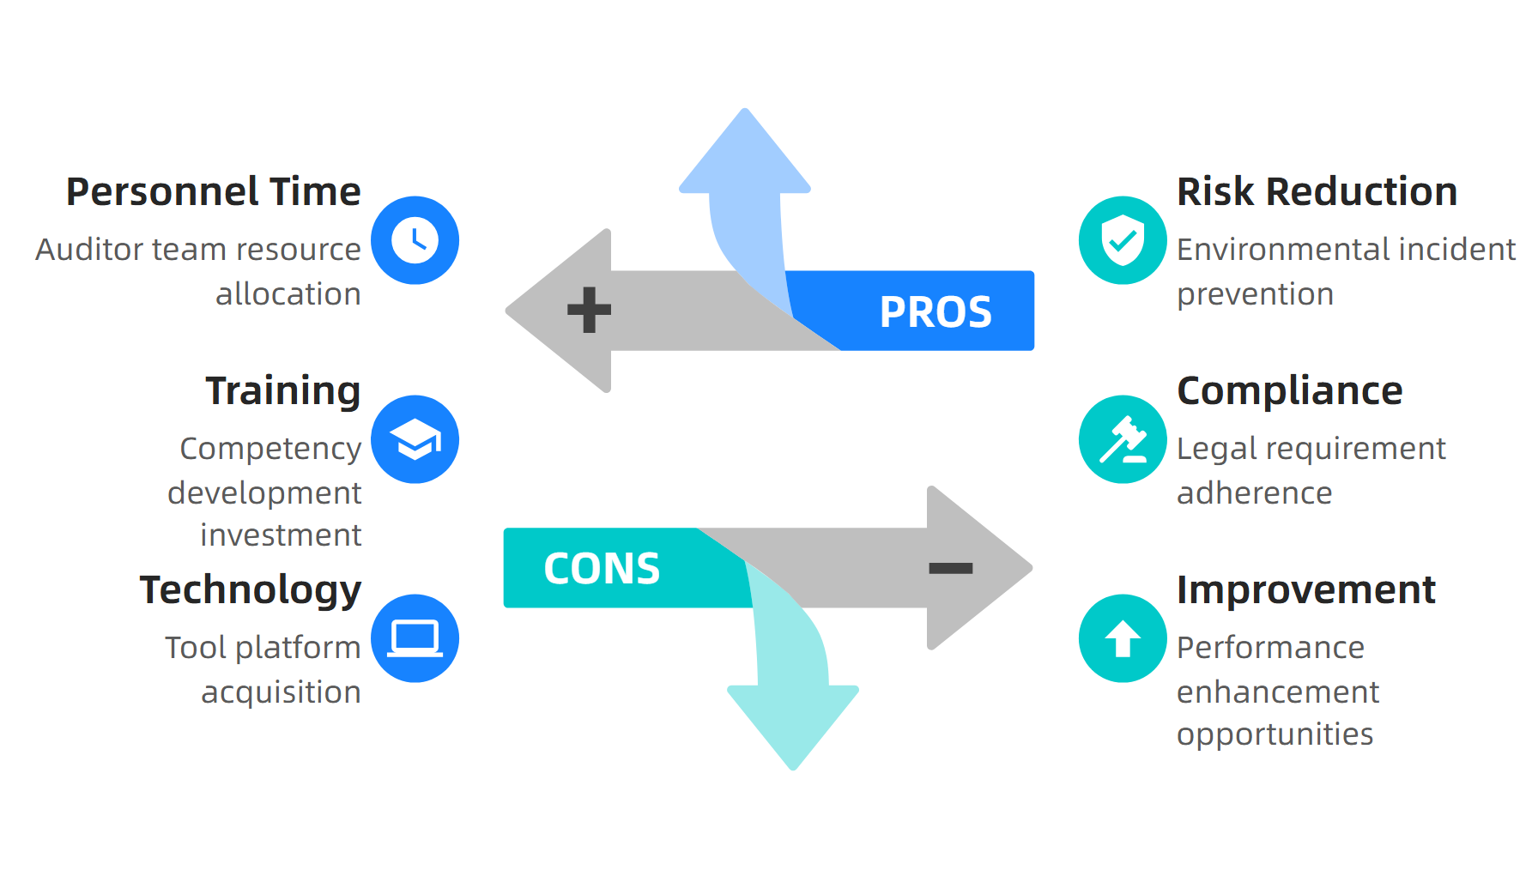
Cost-Benefit Analysis Framework
Source: ISO 14001:2015 Business Case Guidelines
This material belongs to Tertiary Infotech Academy Pte Ltd (UEN: 201200696W). All Rights Reserved

Slide 46
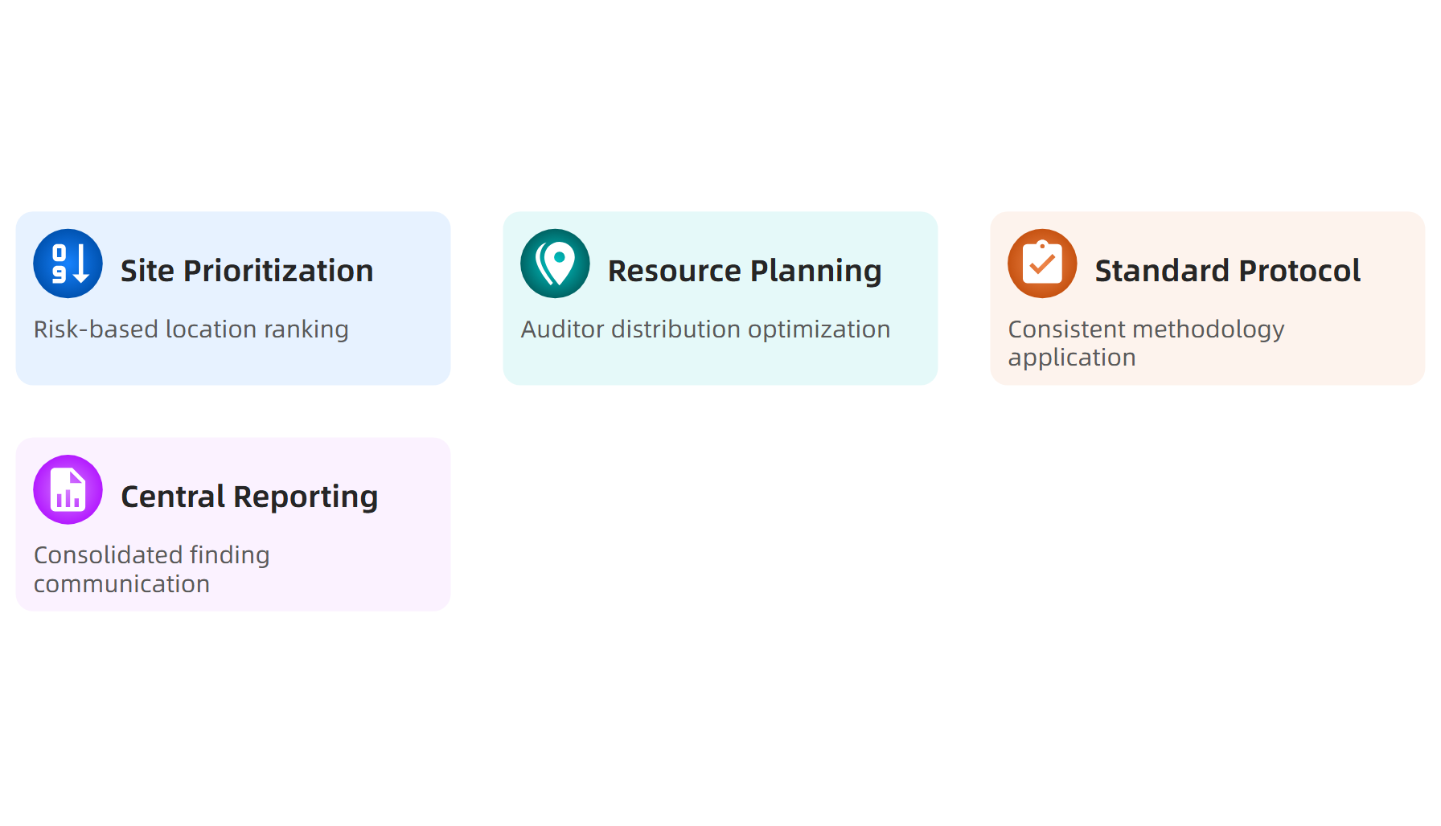
Multi-site Audit Coordination
Source: ISO 14001:2015 Multi-site Guidelines
This material belongs to Tertiary Infotech Academy Pte Ltd (UEN: 201200696W). All Rights Reserved

Slide 47
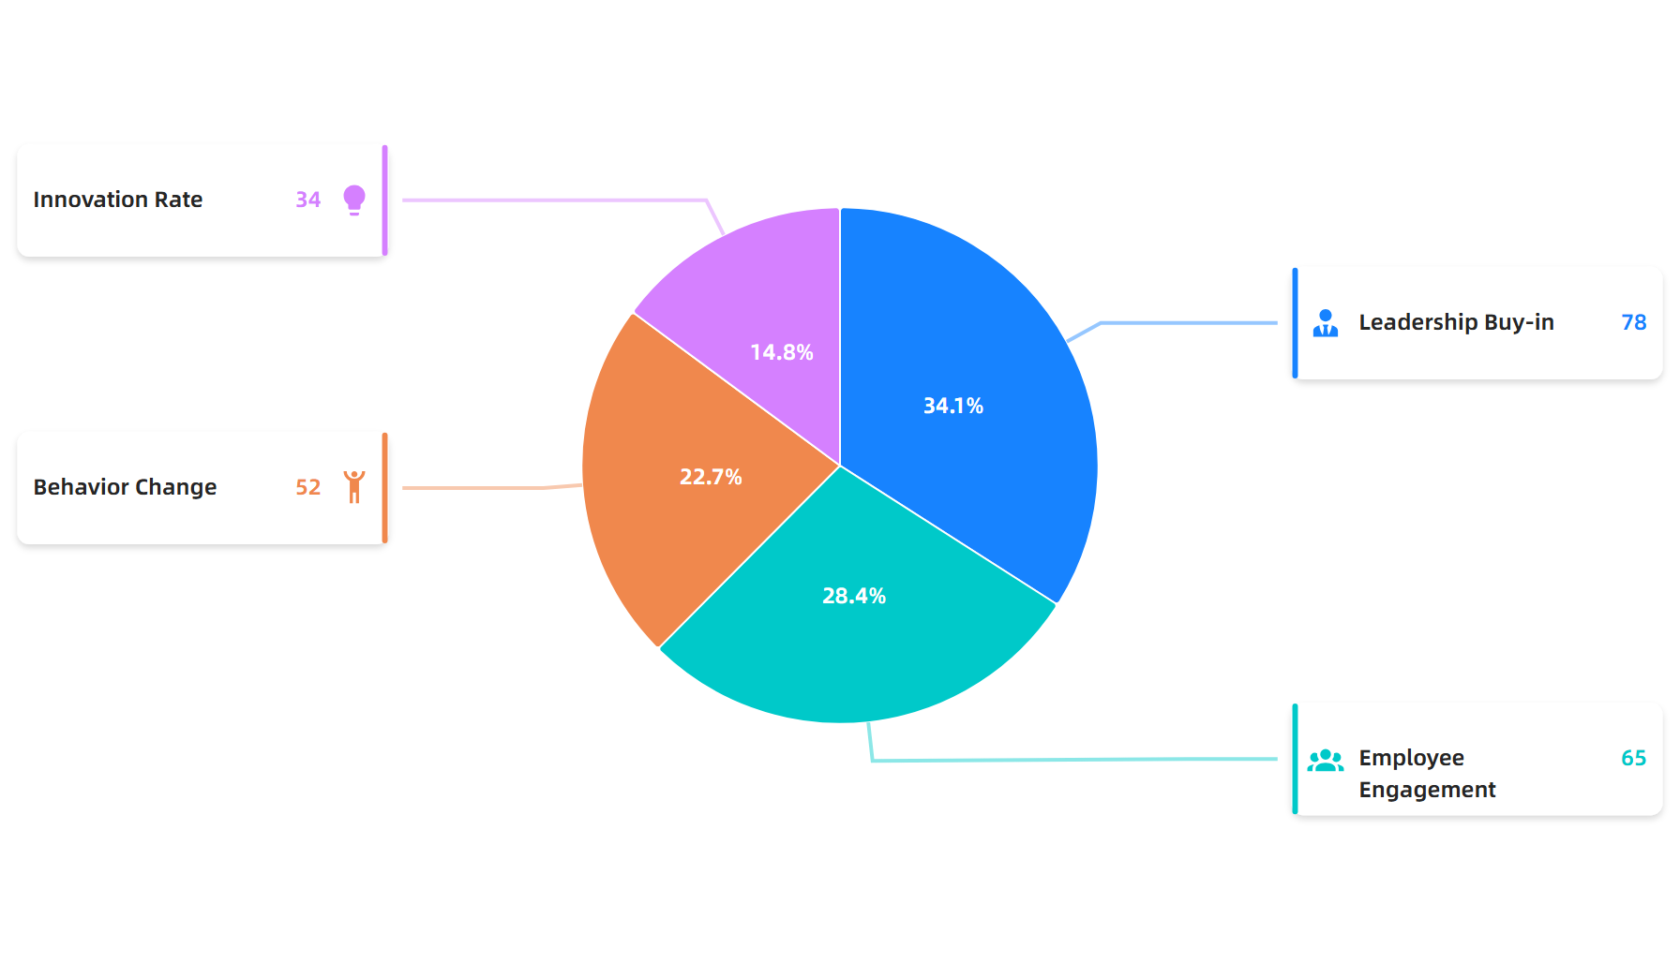
Cultural Change Assessment
Source: ISO 14001:2015 Culture Assessment Benchmarks
This material belongs to Tertiary Infotech Academy Pte Ltd (UEN: 201200696W). All Rights Reserved

Slide 48

Audit Reporting Excellence Framework
Source: ISO 14001:2015 Reporting Standards
This material belongs to Tertiary Infotech Academy Pte Ltd (UEN: 201200696W). All Rights Reserved

Slide 49
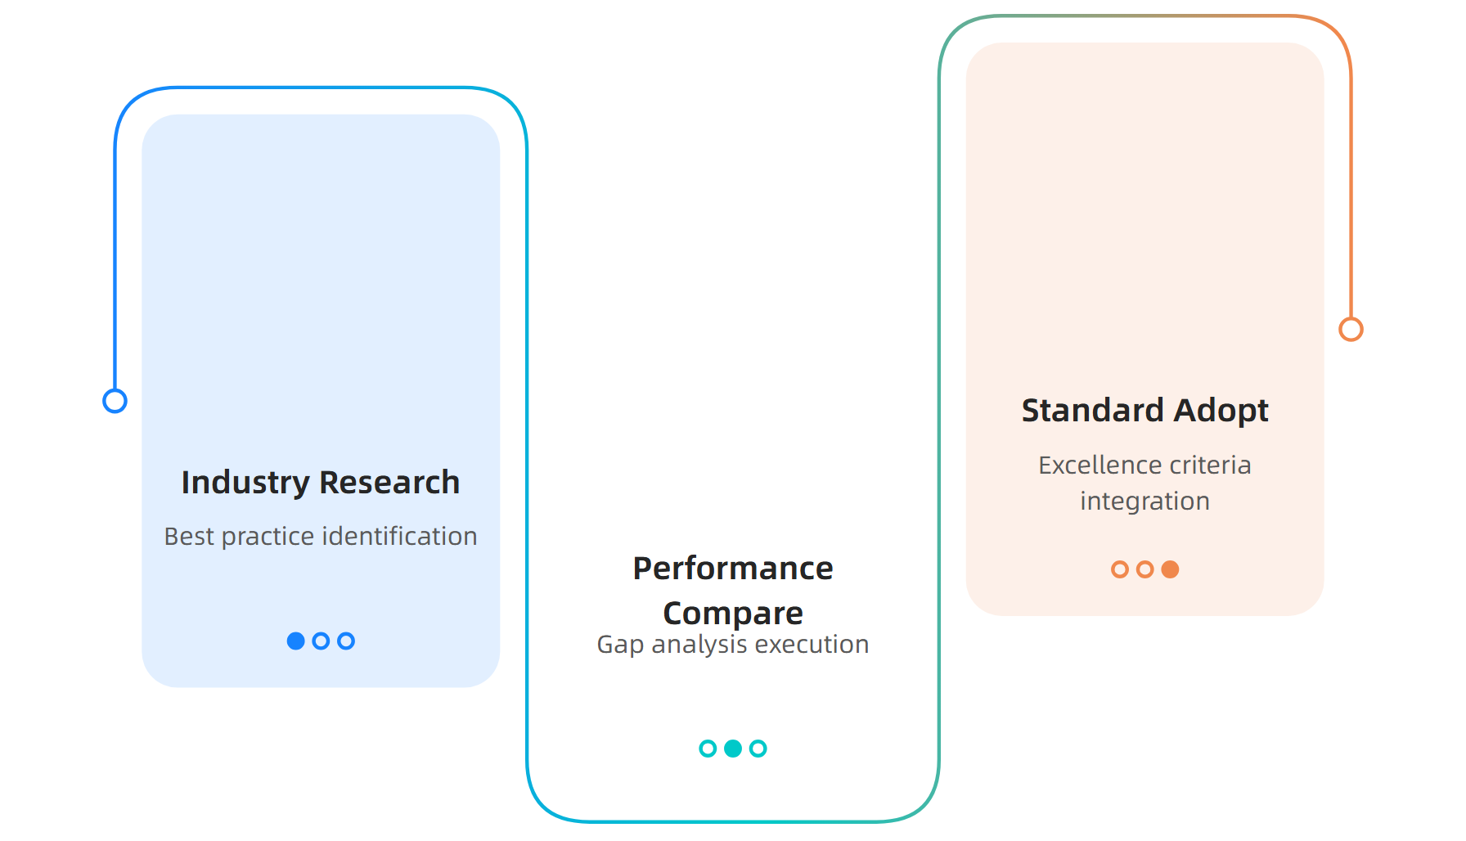
Benchmarking Integration Strategy
Source: ISO 14001:2015 Benchmarking Guidelines
This material belongs to Tertiary Infotech Academy Pte Ltd (UEN: 201200696W). All Rights Reserved

Slide 50
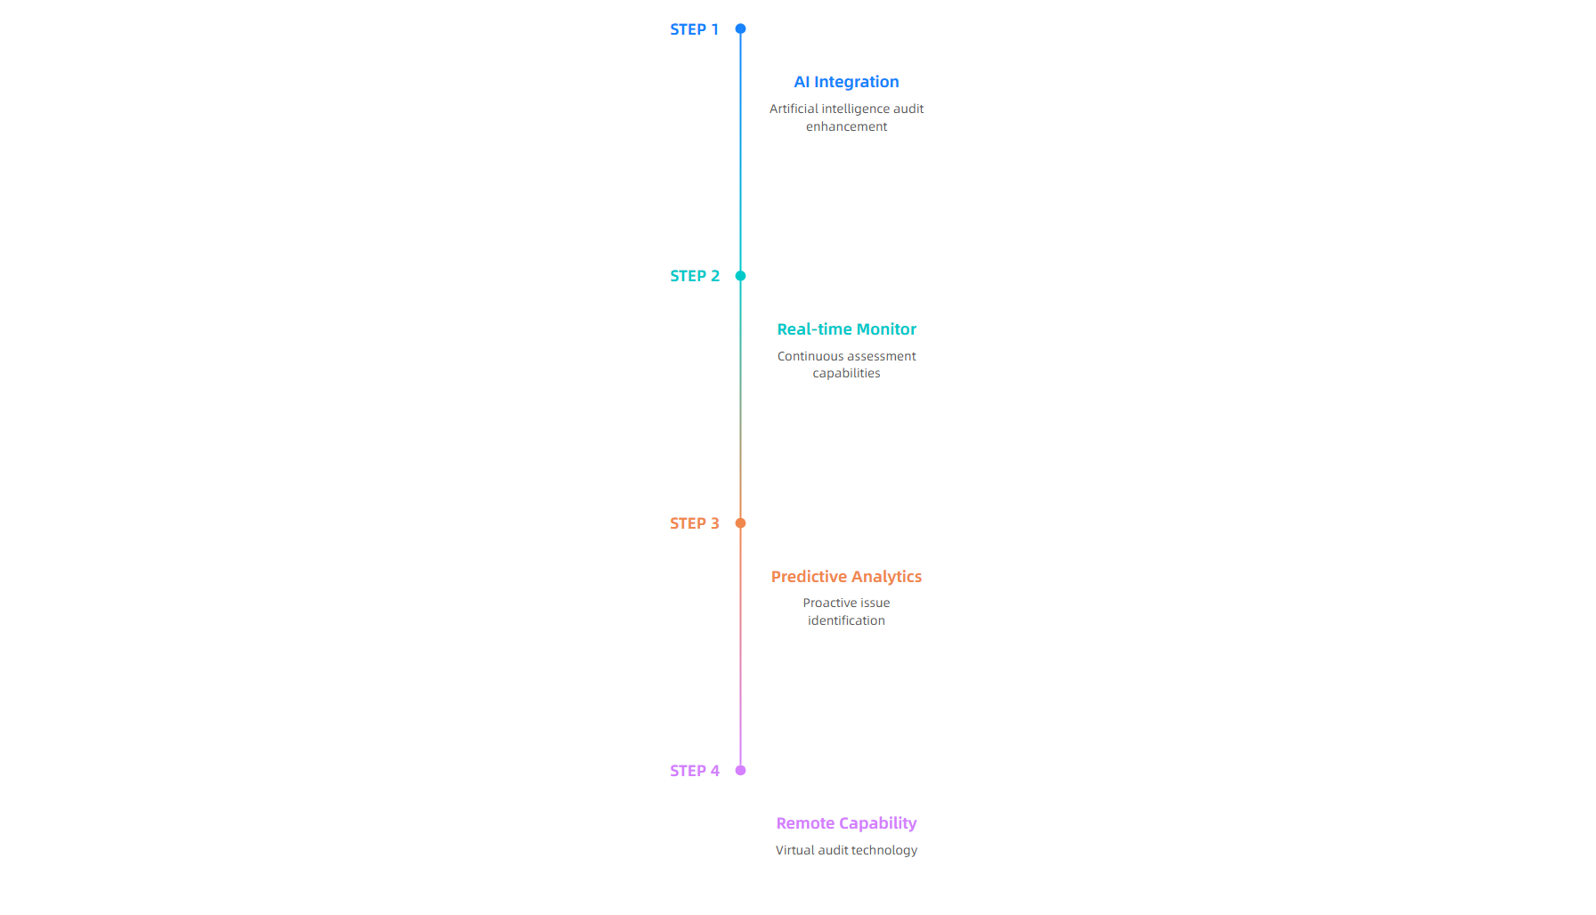
Future Audit Trends Integration
Source: Future Audit Technology Trends, 2024
This material belongs to Tertiary Infotech Academy Pte Ltd (UEN: 201200696W). All Rights Reserved

Slide 51
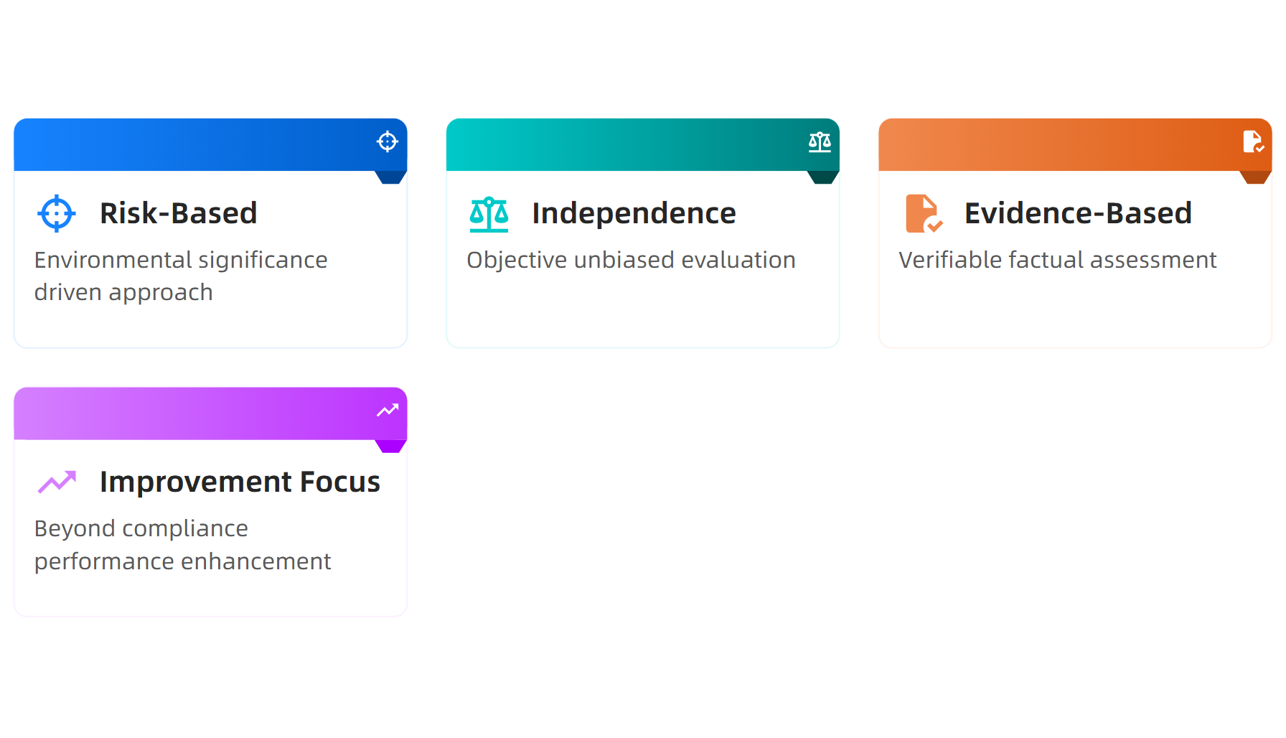
Key Framework Takeaways
Source: ISO 14001:2015 Implementation Summary
This material belongs to Tertiary Infotech Academy Pte Ltd (UEN: 201200696W). All Rights Reserved

Slide 52
Activity: ISO 14001:2015 Internal Auditor Framework
Activity: Risk-Based Audit Planning Exercise
Step 1: Assess environmental significance of each production line using risk matrix
Step 2: Determine appropriate audit frequency for each line based on risk level
Step 3: Select qualified auditors with appropriate competencies for each audit
Step 4: Develop scope and objectives for upcoming audit cycle
Step 5: Create audit schedule aligned with risk-based methodology
This material belongs to Tertiary Infotech Academy Pte Ltd (UEN: 201200696W). All Rights Reserved

Slide 53
LO2 | LU2 | T1: Auditing ISO 14001:2015

Slide 54
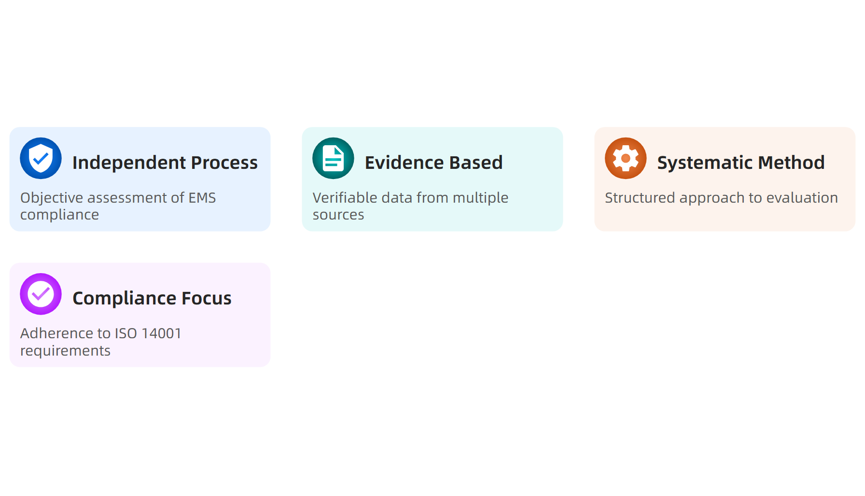
What is Auditing ISO 14001:2015?
Source: ISOQAR, 2024
This material belongs to Tertiary Infotech Academy Pte Ltd (UEN: 201200696W). All Rights Reserved

Slide 55
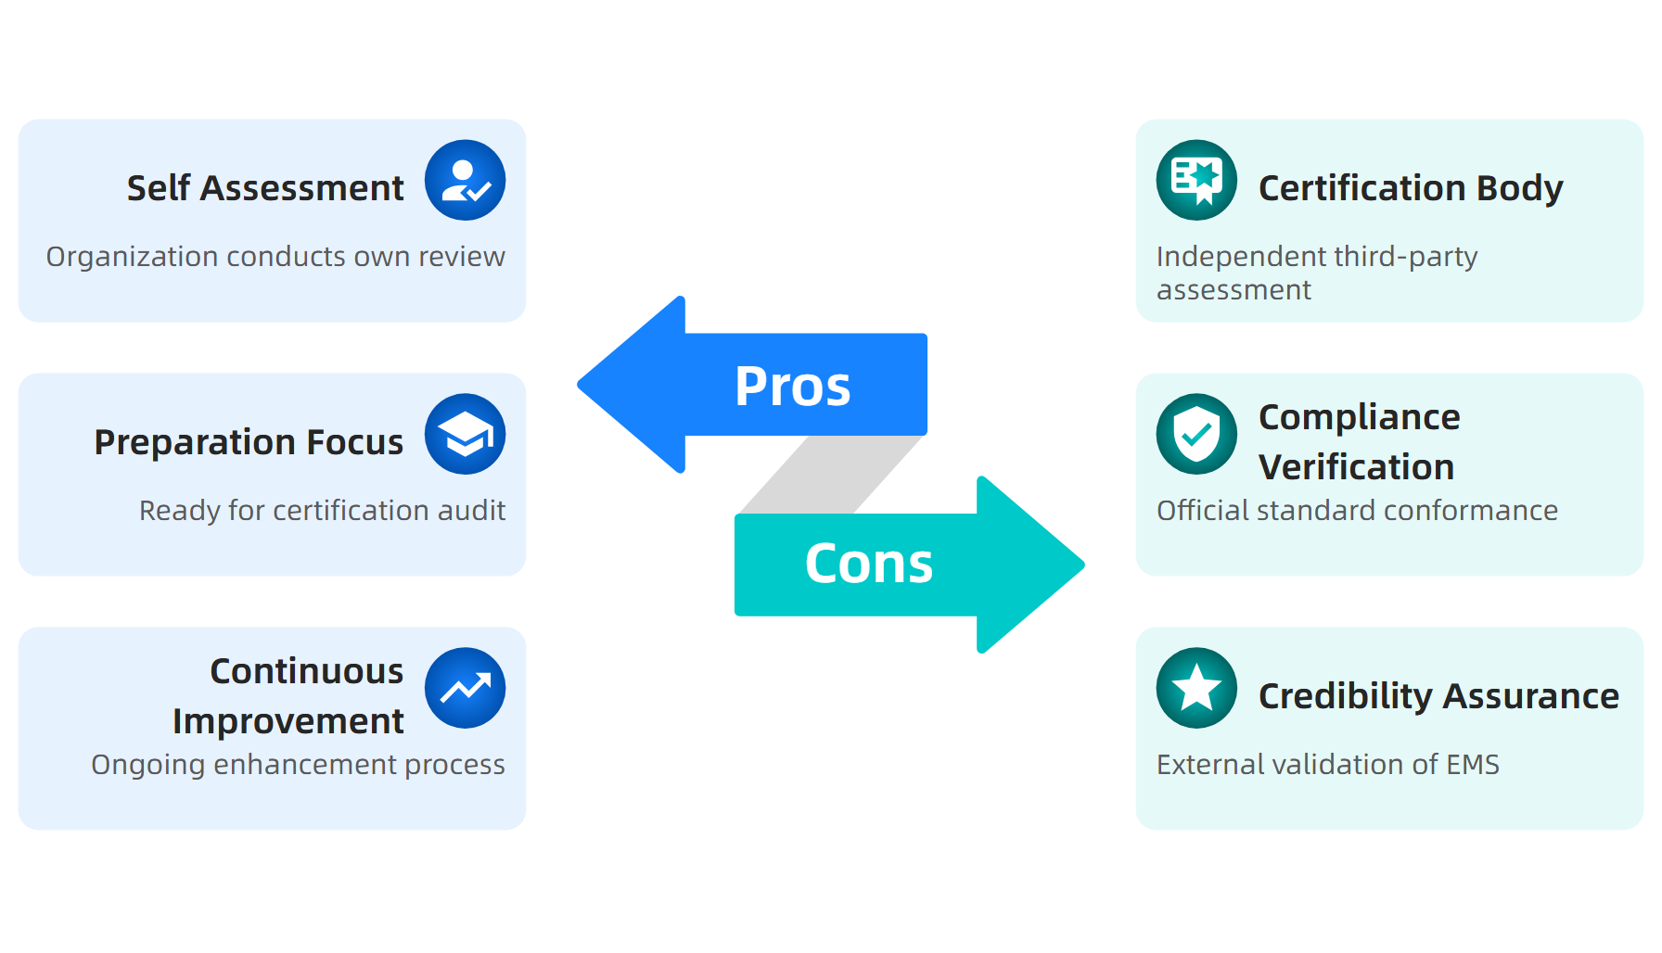
Types of ISO 14001 Audits
Source: GoAudits, 2024
This material belongs to Tertiary Infotech Academy Pte Ltd (UEN: 201200696W). All Rights Reserved

Slide 56
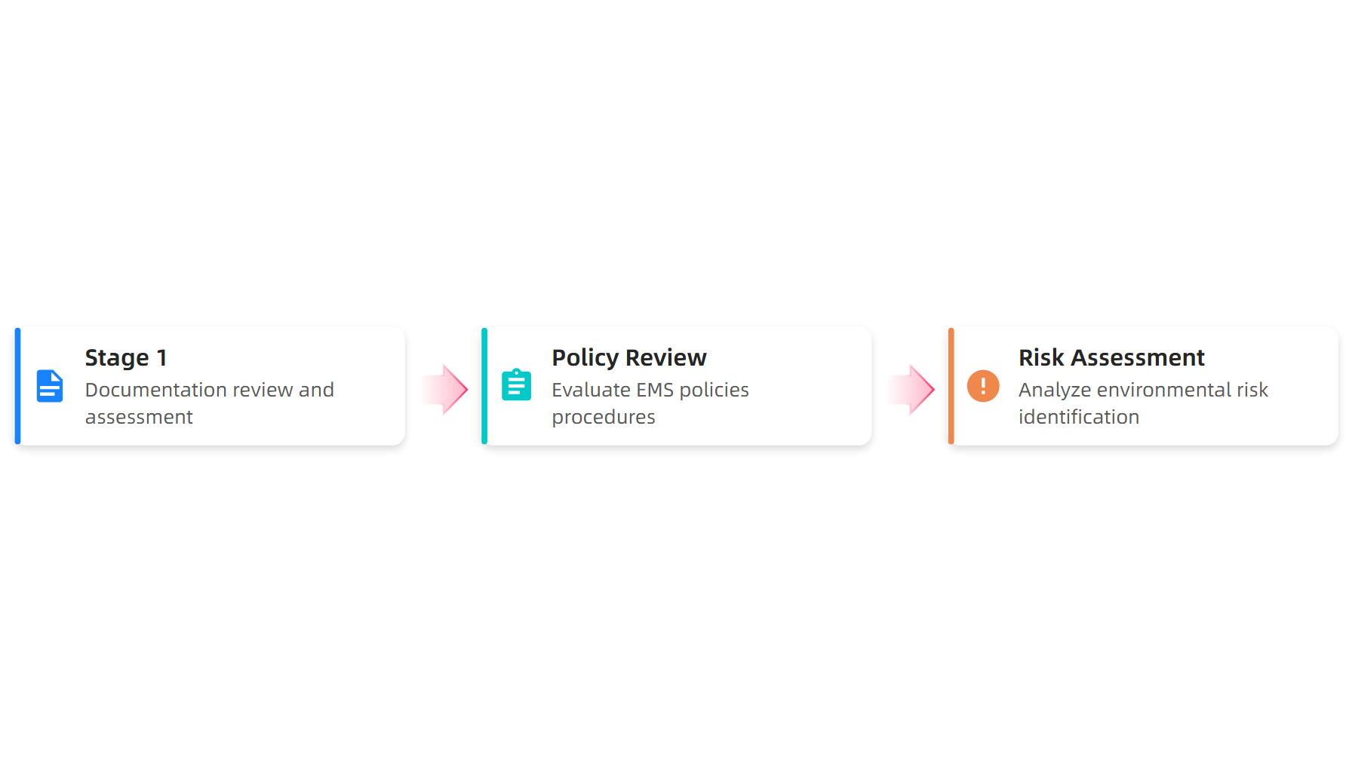
Two-Stage Certification Process
Source: Smithers, 2024
This material belongs to Tertiary Infotech Academy Pte Ltd (UEN: 201200696W). All Rights Reserved

Slide 57
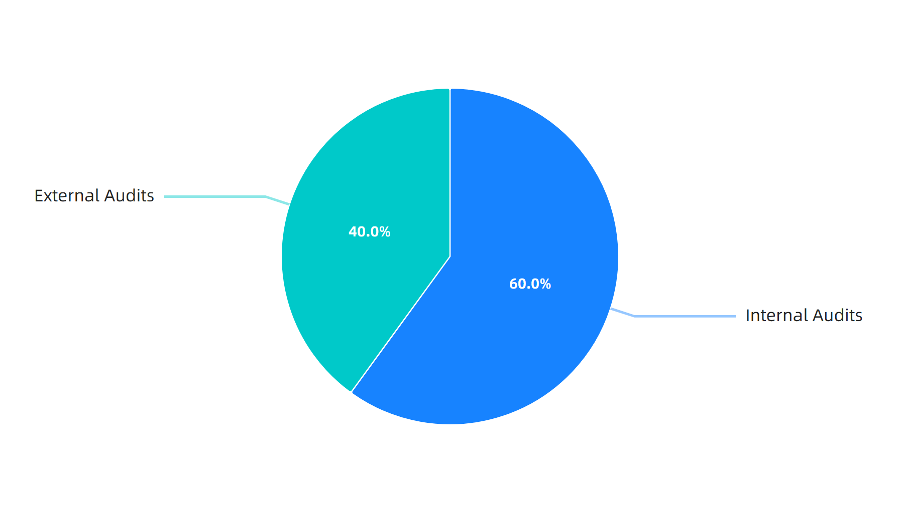
Audit Distribution Statistics
Source: GoAudits, 2024
This material belongs to Tertiary Infotech Academy Pte Ltd (UEN: 201200696W). All Rights Reserved

Slide 58
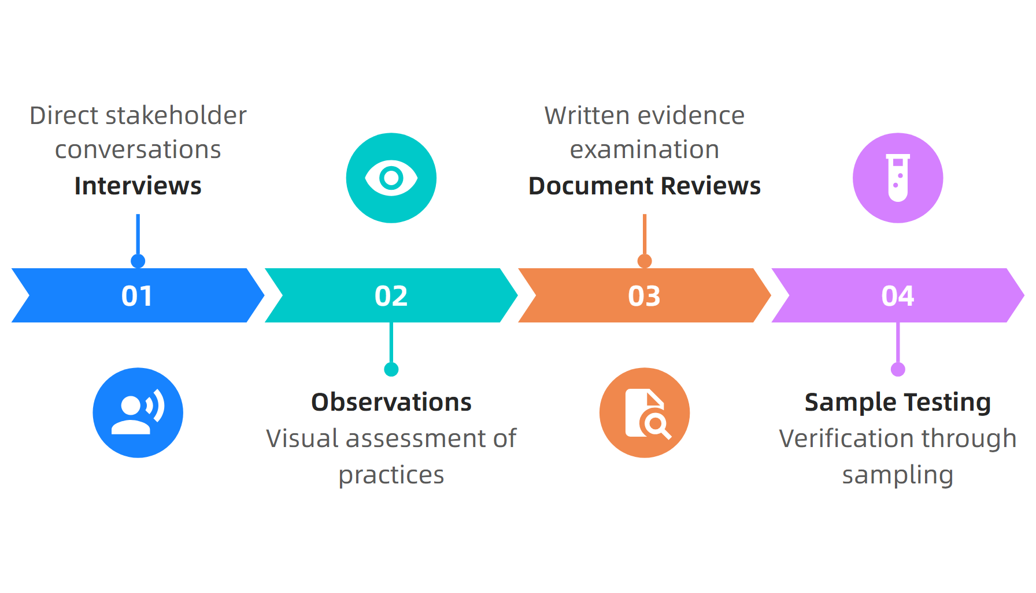
Evidence Gathering Techniques
Source: BPR Hub, 2024
This material belongs to Tertiary Infotech Academy Pte Ltd (UEN: 201200696W). All Rights Reserved

Slide 59
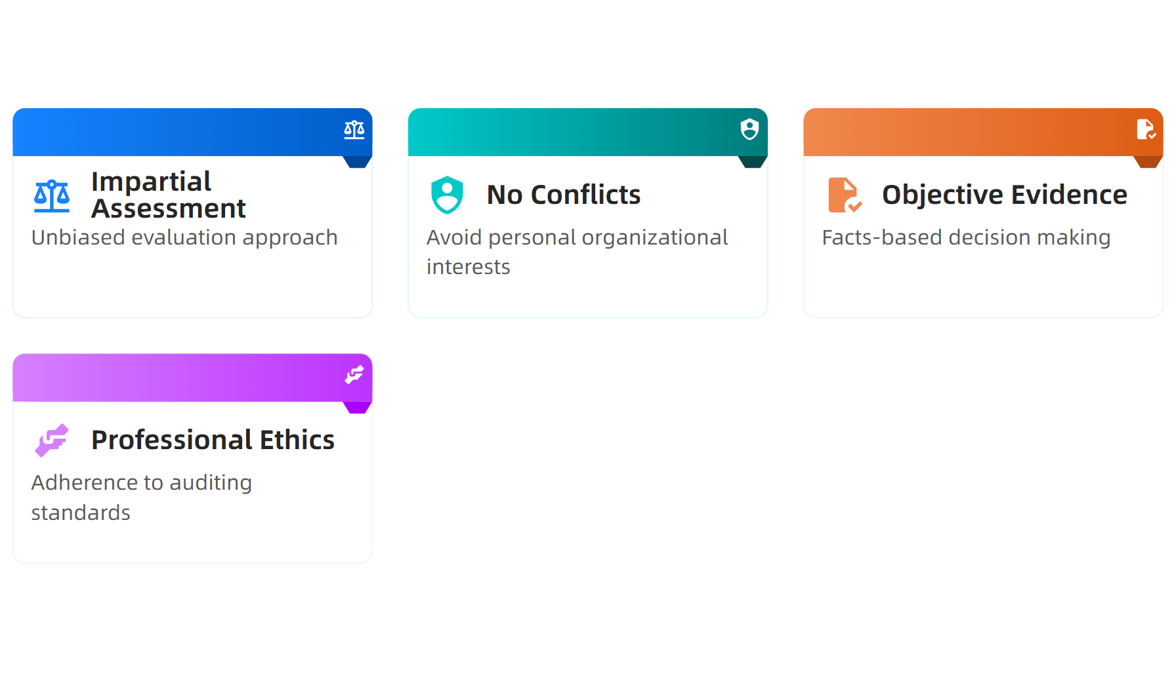
Auditor Independence Requirements
Source: ISOQAR, 2024
This material belongs to Tertiary Infotech Academy Pte Ltd (UEN: 201200696W). All Rights Reserved

Slide 60
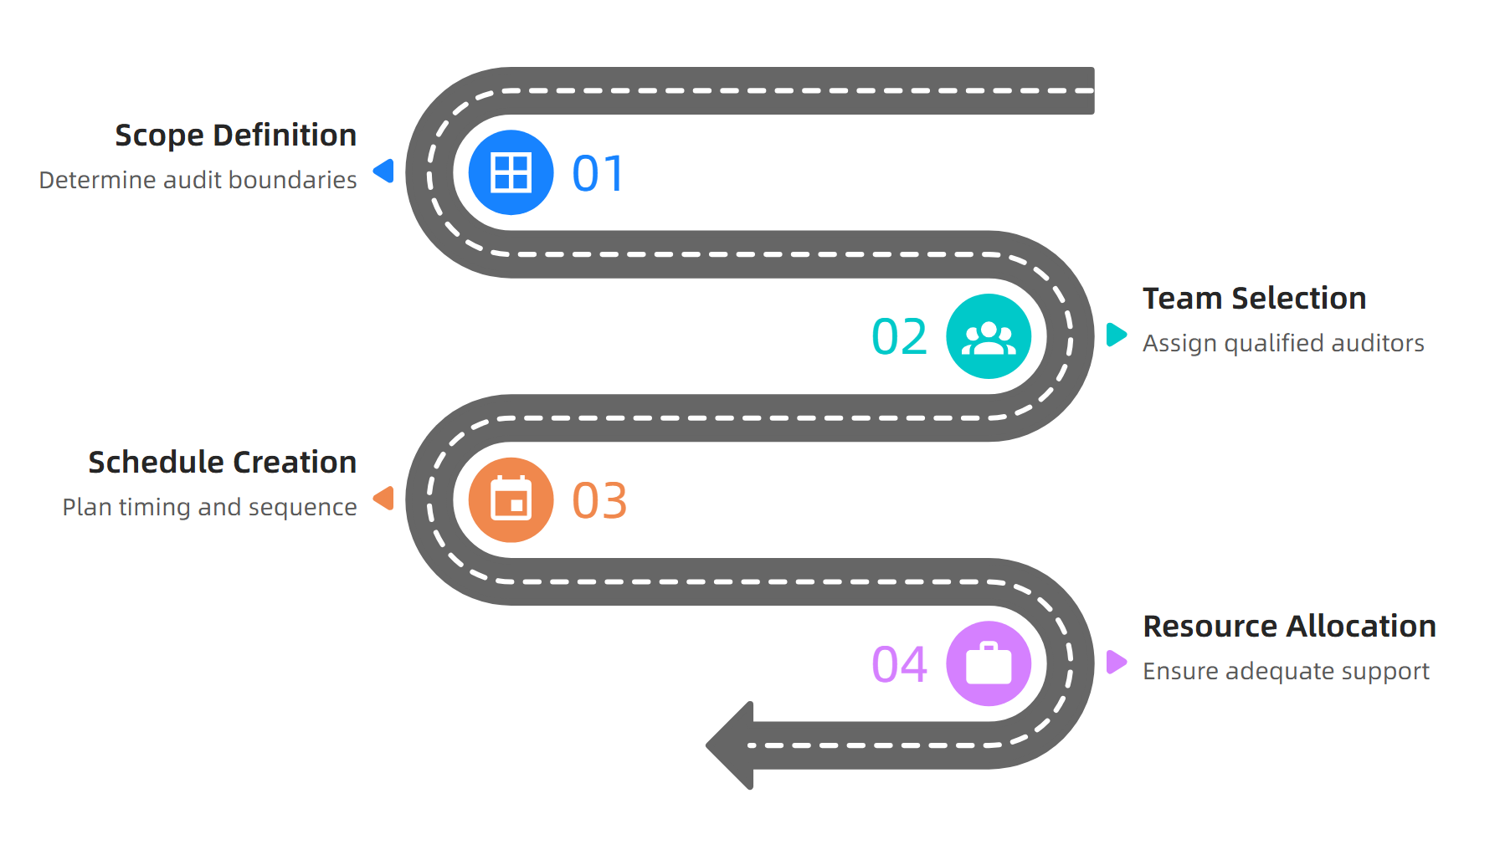
Audit Planning Process
Source: Internal Audit Check Sheets, 2024
This material belongs to Tertiary Infotech Academy Pte Ltd (UEN: 201200696W). All Rights Reserved

Slide 61
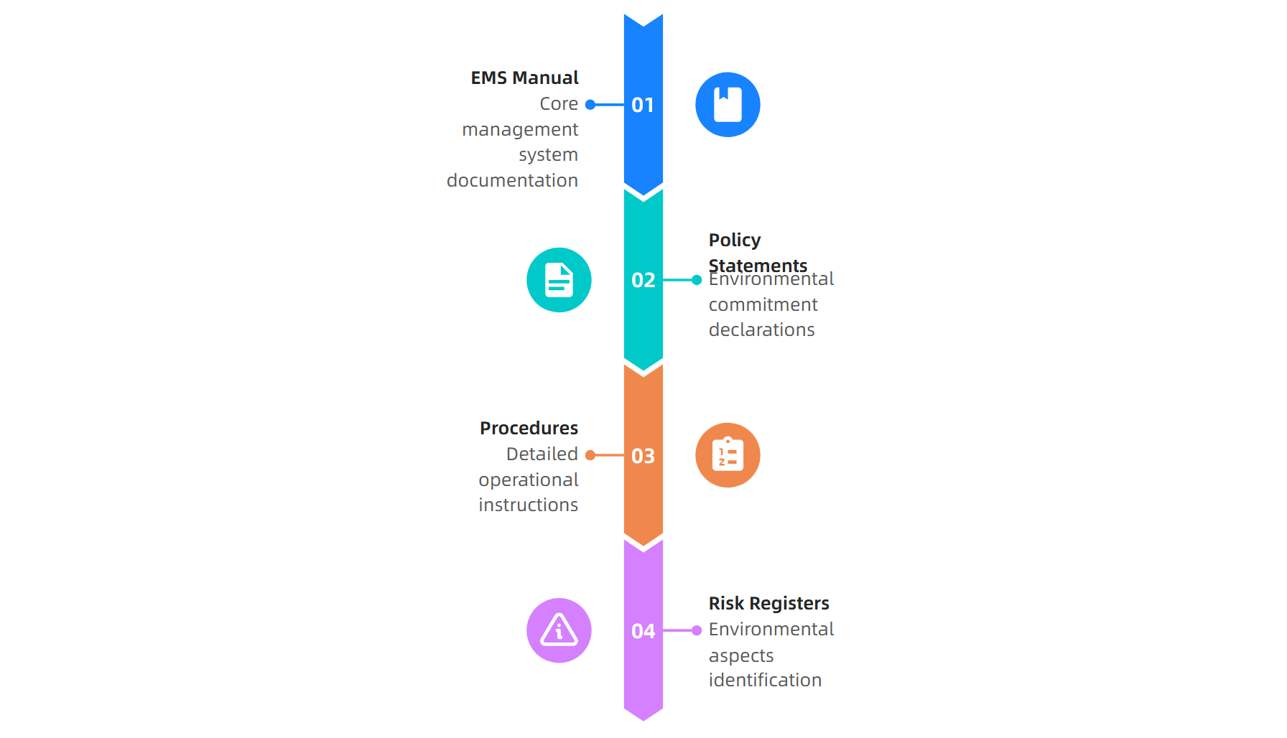
Documentation Review Phase
Source: ISOQAR, 2024
This material belongs to Tertiary Infotech Academy Pte Ltd (UEN: 201200696W). All Rights Reserved

Slide 62

Implementation Assessment
Source: Smithers, 2024
This material belongs to Tertiary Infotech Academy Pte Ltd (UEN: 201200696W). All Rights Reserved

Slide 63
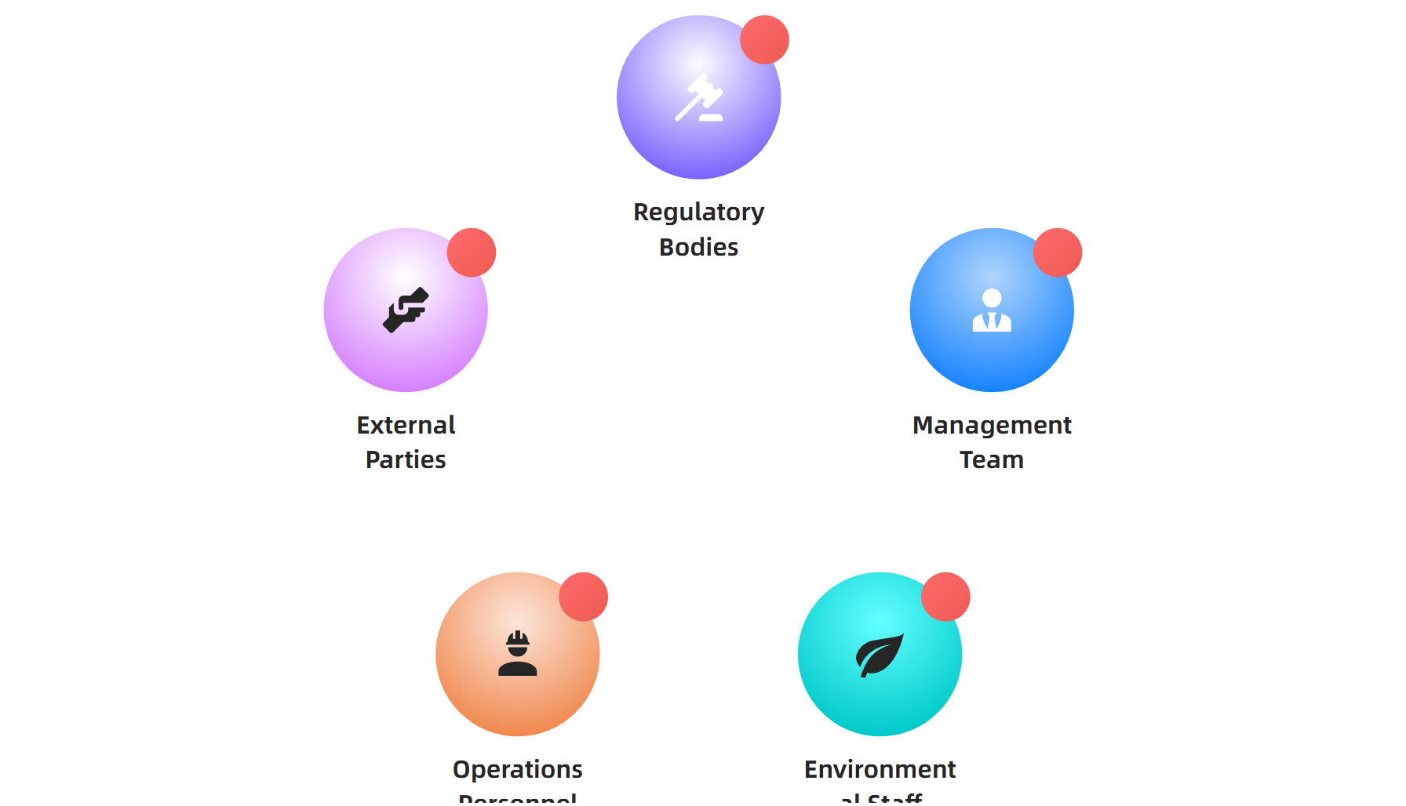
Stakeholder Engagement Strategy
Source: BPR Hub, 2024
This material belongs to Tertiary Infotech Academy Pte Ltd (UEN: 201200696W). All Rights Reserved

Slide 64
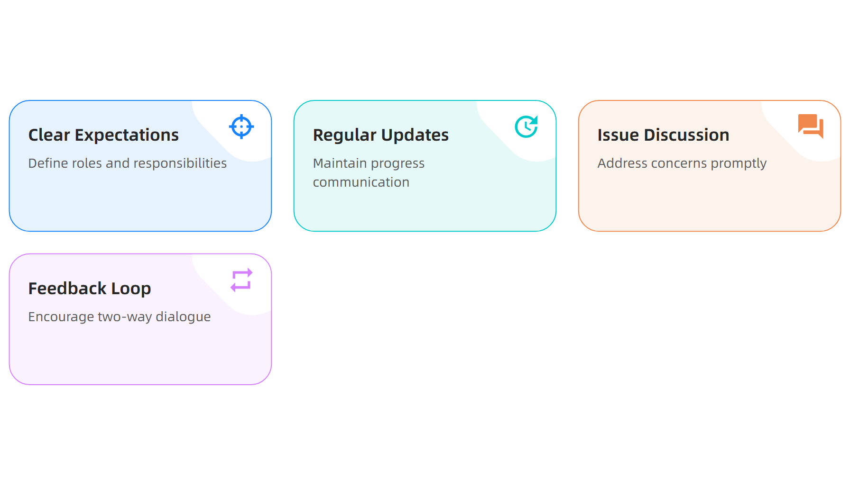
Communication Best Practices
Source: 10 Key Strategies, 2024
This material belongs to Tertiary Infotech Academy Pte Ltd (UEN: 201200696W). All Rights Reserved

Slide 65
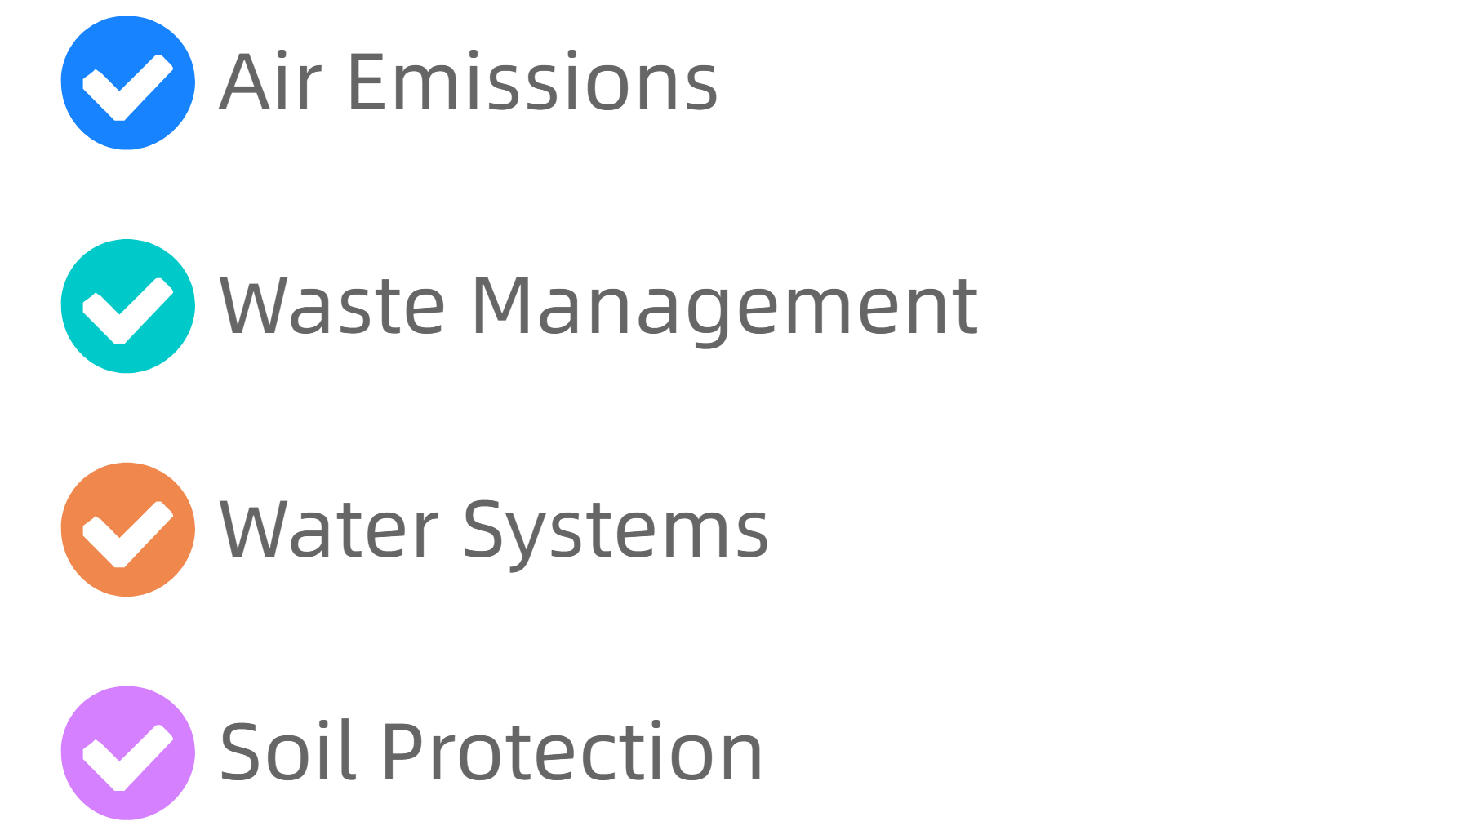
Checklist Methodology
Source: Internal Audit Check Sheets, 2024
This material belongs to Tertiary Infotech Academy Pte Ltd (UEN: 201200696W). All Rights Reserved

Slide 66

Audit Program Structure
Source: Internal Audit Check Sheets, 2024
This material belongs to Tertiary Infotech Academy Pte Ltd (UEN: 201200696W). All Rights Reserved

Slide 67

Evidence Sampling Strategy
Source: Internal Audit Check Sheets, 2024
This material belongs to Tertiary Infotech Academy Pte Ltd (UEN: 201200696W). All Rights Reserved

Slide 68

Stage Distribution Balance
Source: ISOQAR, 2024
This material belongs to Tertiary Infotech Academy Pte Ltd (UEN: 201200696W). All Rights Reserved

Slide 69

Continuous Improvement Cycle
Source: BPR Hub, 2024
This material belongs to Tertiary Infotech Academy Pte Ltd (UEN: 201200696W). All Rights Reserved

Slide 70

Follow-up Audit Process
Source: BPR Hub, 2024
This material belongs to Tertiary Infotech Academy Pte Ltd (UEN: 201200696W). All Rights Reserved

Slide 71

Risk-Based Auditing
Source: ISOQAR, 2024
This material belongs to Tertiary Infotech Academy Pte Ltd (UEN: 201200696W). All Rights Reserved

Slide 72

Technology Integration
Source: GoAudits, 2024
This material belongs to Tertiary Infotech Academy Pte Ltd (UEN: 201200696W). All Rights Reserved

Slide 73

Competence Requirements
Source: ISOQAR, 2024
This material belongs to Tertiary Infotech Academy Pte Ltd (UEN: 201200696W). All Rights Reserved

Slide 74

Non-Conformity Classification
Source: Internal Audit Check Sheets, 2024
This material belongs to Tertiary Infotech Academy Pte Ltd (UEN: 201200696W). All Rights Reserved

Slide 75

Interview Strategies
Source: BPR Hub, 2024
This material belongs to Tertiary Infotech Academy Pte Ltd (UEN: 201200696W). All Rights Reserved

Slide 76

Observation Techniques
Source: BPR Hub, 2024
This material belongs to Tertiary Infotech Academy Pte Ltd (UEN: 201200696W). All Rights Reserved

Slide 77

Reporting Framework
Source: ISOQAR, 2024
This material belongs to Tertiary Infotech Academy Pte Ltd (UEN: 201200696W). All Rights Reserved

Slide 78

Management Review Integration
Source: GoAudits, 2024
This material belongs to Tertiary Infotech Academy Pte Ltd (UEN: 201200696W). All Rights Reserved

Slide 79

Quality Control Measures
Source: Internal Audit Check Sheets, 2024
This material belongs to Tertiary Infotech Academy Pte Ltd (UEN: 201200696W). All Rights Reserved

Slide 80

Cultural Considerations
Source: 10 Key Strategies, 2024
This material belongs to Tertiary Infotech Academy Pte Ltd (UEN: 201200696W). All Rights Reserved

Slide 81

Remote Auditing Capabilities
Source: GoAudits, 2024
This material belongs to Tertiary Infotech Academy Pte Ltd (UEN: 201200696W). All Rights Reserved

Slide 82

Supplier Audit Integration
Source: ISOQAR, 2024
This material belongs to Tertiary Infotech Academy Pte Ltd (UEN: 201200696W). All Rights Reserved

Slide 83

Emergency Preparedness Assessment
Source: Internal Audit Check Sheets, 2024
This material belongs to Tertiary Infotech Academy Pte Ltd (UEN: 201200696W). All Rights Reserved

Slide 84

Legal Compliance Verification
Source: ISOQAR, 2024
This material belongs to Tertiary Infotech Academy Pte Ltd (UEN: 201200696W). All Rights Reserved

Slide 85

Performance Measurement Review
Source: GoAudits, 2024
This material belongs to Tertiary Infotech Academy Pte Ltd (UEN: 201200696W). All Rights Reserved

Slide 86

Training Effectiveness Evaluation
Source: 10 Key Strategies, 2024
This material belongs to Tertiary Infotech Academy Pte Ltd (UEN: 201200696W). All Rights Reserved

Slide 87

Change Management Assessment
Source: BPR Hub, 2024
This material belongs to Tertiary Infotech Academy Pte Ltd (UEN: 201200696W). All Rights Reserved

Slide 88

Internal Communication Review
Source: 10 Key Strategies, 2024
This material belongs to Tertiary Infotech Academy Pte Ltd (UEN: 201200696W). All Rights Reserved

Slide 89

External Communication Audit
Source: ISOQAR, 2024
This material belongs to Tertiary Infotech Academy Pte Ltd (UEN: 201200696W). All Rights Reserved

Slide 90

Corrective Action Tracking
Source: BPR Hub, 2024
This material belongs to Tertiary Infotech Academy Pte Ltd (UEN: 201200696W). All Rights Reserved

Slide 91

Cost-Benefit Analysis
Source: GoAudits, 2024
This material belongs to Tertiary Infotech Academy Pte Ltd (UEN: 201200696W). All Rights Reserved

Slide 92

Key Auditing Takeaways
Source: Multiple sources, 2024
This material belongs to Tertiary Infotech Academy Pte Ltd (UEN: 201200696W). All Rights Reserved

Slide 93
Activity: Auditing ISO 14001:2015
Activity: Internal Audit Planning Exercise
Step 1: Define audit scope boundaries for each production line
Step 2: Create stakeholder engagement matrix identifying key personnel
Step 3: Develop evidence gathering strategy using multiple techniques
Step 4: Design checklist covering all environmental aspects
Step 5: Plan follow-up procedures for continuous improvement
This material belongs to Tertiary Infotech Academy Pte Ltd (UEN: 201200696W). All Rights Reserved

Slide 94
LO3 | LU3 | T1: Risk Assessment

Slide 95

Risk Assessment Fundamentals
Source: NIST, 2024
This material belongs to Tertiary Infotech Academy Pte Ltd (UEN: 201200696W). All Rights Reserved

Slide 96

Four-Step Process
Source: NIST, 2024
This material belongs to Tertiary Infotech Academy Pte Ltd (UEN: 201200696W). All Rights Reserved

Slide 97

Framework Types
Source: TechTarget, 2024
This material belongs to Tertiary Infotech Academy Pte Ltd (UEN: 201200696W). All Rights Reserved

Slide 98

Risk Scoring Scale
Source: LogicManager, 2024
This material belongs to Tertiary Infotech Academy Pte Ltd (UEN: 201200696W). All Rights Reserved

Slide 99

Assessment Tools
Source: SafetyCulture, 2024
This material belongs to Tertiary Infotech Academy Pte Ltd (UEN: 201200696W). All Rights Reserved

Slide 100

Statistical Techniques
Source: StudySmarter, 2024
This material belongs to Tertiary Infotech Academy Pte Ltd (UEN: 201200696W). All Rights Reserved

Slide 101

Risk Distribution
Source: NIST, 2024
This material belongs to Tertiary Infotech Academy Pte Ltd (UEN: 201200696W). All Rights Reserved

Slide 102

Assessment Components
Source: NIST, 2024
This material belongs to Tertiary Infotech Academy Pte Ltd (UEN: 201200696W). All Rights Reserved

Slide 103

Preparation Phase
Source: NIST, 2024
This material belongs to Tertiary Infotech Academy Pte Ltd (UEN: 201200696W). All Rights Reserved

Slide 104

Data Collection
Source: LogicManager, 2024
This material belongs to Tertiary Infotech Academy Pte Ltd (UEN: 201200696W). All Rights Reserved

Slide 105

Threat Identification
Source: NIST, 2024
This material belongs to Tertiary Infotech Academy Pte Ltd (UEN: 201200696W). All Rights Reserved

Slide 106

Risk Matrix
Source: SafetyCulture, 2024
This material belongs to Tertiary Infotech Academy Pte Ltd (UEN: 201200696W). All Rights Reserved

Slide 107

FMEA Process
Source: SafetyCulture, 2024
This material belongs to Tertiary Infotech Academy Pte Ltd (UEN: 201200696W). All Rights Reserved

Slide 108

Decision Trees
Source: SafetyCulture, 2024
This material belongs to Tertiary Infotech Academy Pte Ltd (UEN: 201200696W). All Rights Reserved

Slide 109

Bowtie Model
Source: SafetyCulture, 2024
This material belongs to Tertiary Infotech Academy Pte Ltd (UEN: 201200696W). All Rights Reserved

Slide 110

Cross-Functional Teams
Source: SafetyCulture, 2024
This material belongs to Tertiary Infotech Academy Pte Ltd (UEN: 201200696W). All Rights Reserved

Slide 111

Vulnerability Analysis
Source: NIST, 2024
This material belongs to Tertiary Infotech Academy Pte Ltd (UEN: 201200696W). All Rights Reserved

Slide 112

Impact Assessment
Source: NIST, 2024
This material belongs to Tertiary Infotech Academy Pte Ltd (UEN: 201200696W). All Rights Reserved

Slide 113

Quantitative Methods
Source: StudySmarter, 2024
This material belongs to Tertiary Infotech Academy Pte Ltd (UEN: 201200696W). All Rights Reserved

Slide 114

ALE Calculation
Source: StudySmarter, 2024
This material belongs to Tertiary Infotech Academy Pte Ltd (UEN: 201200696W). All Rights Reserved

Slide 115

Risk Communication
Source: NIST, 2024
This material belongs to Tertiary Infotech Academy Pte Ltd (UEN: 201200696W). All Rights Reserved

Slide 116

Risk Monitoring
Source: SafetyCulture, 2024
This material belongs to Tertiary Infotech Academy Pte Ltd (UEN: 201200696W). All Rights Reserved

Slide 117

Risk Tolerance
Source: LogicManager, 2024
This material belongs to Tertiary Infotech Academy Pte Ltd (UEN: 201200696W). All Rights Reserved

Slide 118

Control Categories
Source: NIST, 2024
This material belongs to Tertiary Infotech Academy Pte Ltd (UEN: 201200696W). All Rights Reserved

Slide 119

Risk Register
Source: LogicManager, 2024
This material belongs to Tertiary Infotech Academy Pte Ltd (UEN: 201200696W). All Rights Reserved

Slide 120

Assessment Quality
Source: NIST, 2024
This material belongs to Tertiary Infotech Academy Pte Ltd (UEN: 201200696W). All Rights Reserved

Slide 121

FAIR Model
Source: StudySmarter, 2024
This material belongs to Tertiary Infotech Academy Pte Ltd (UEN: 201200696W). All Rights Reserved

Slide 122

Risk Treatment
Source: NIST, 2024
This material belongs to Tertiary Infotech Academy Pte Ltd (UEN: 201200696W). All Rights Reserved

Slide 123

Assessment Timeline
Source: LogicManager, 2024
This material belongs to Tertiary Infotech Academy Pte Ltd (UEN: 201200696W). All Rights Reserved

Slide 124

Industry Standards
Source: TechTarget, 2024
This material belongs to Tertiary Infotech Academy Pte Ltd (UEN: 201200696W). All Rights Reserved

Slide 125

Technology Tools
Source: StudySmarter, 2024
This material belongs to Tertiary Infotech Academy Pte Ltd (UEN: 201200696W). All Rights Reserved

Slide 126

Common Pitfalls
Source: LogicManager, 2024
This material belongs to Tertiary Infotech Academy Pte Ltd (UEN: 201200696W). All Rights Reserved

Slide 127

Success Factors
Source: SafetyCulture, 2024
This material belongs to Tertiary Infotech Academy Pte Ltd (UEN: 201200696W). All Rights Reserved

Slide 128

Reporting Format
Source: NIST, 2024
This material belongs to Tertiary Infotech Academy Pte Ltd (UEN: 201200696W). All Rights Reserved

Slide 129

Compliance Integration
Source: TechTarget, 2024
This material belongs to Tertiary Infotech Academy Pte Ltd (UEN: 201200696W). All Rights Reserved

Slide 130

Risk Metrics
Source: LogicManager, 2024
This material belongs to Tertiary Infotech Academy Pte Ltd (UEN: 201200696W). All Rights Reserved

Slide 131

Assessment Maturity
Source: SafetyCulture, 2024
This material belongs to Tertiary Infotech Academy Pte Ltd (UEN: 201200696W). All Rights Reserved

Slide 132

Future Trends
Source: TechTarget, 2024
This material belongs to Tertiary Infotech Academy Pte Ltd (UEN: 201200696W). All Rights Reserved

Slide 133

Key Takeaways
Source: Multiple sources, 2024
This material belongs to Tertiary Infotech Academy Pte Ltd (UEN: 201200696W). All Rights Reserved

Slide 134
Activity: Risk Assessment
Activity: Risk Assessment Workshop
Step 1: Define assessment scope and boundaries
Step 2: Identify potential threats and vulnerabilities
Step 3: Apply risk matrix to evaluate probability and impact
Step 4: Calculate risk scores using 1-10 scale
Step 5: Recommend treatment strategies for high risks
This material belongs to Tertiary Infotech Academy Pte Ltd (UEN: 201200696W). All Rights Reserved

Slide 135
Summary & Q&A

Slide 136

Cert & TRAQOM Survey (Mandatory)
https://lms-tms.tertiaryinfotech.com/

Slide 137
Digital Attendance
It is mandatory for you to take both AM, PM and Assessment digital attendance.
Please scan the QR code from your mobile phone camera and submit your attendance.
Ensure your attendance is recorded for all course days.
This is required for funding and certification purposes.
This material belongs to Tertiary Infotech Academy Pte Ltd (UEN: 201200696W). All Rights Reserved

Slide 138
Final Assessment

Slide 139
Support
If you have any enquiries during and after the class, you can contact us below
  Email: enquiry@tertiaryinfotech.com
  Tel: +65 6318 4588
  Website: www.tertiarycourses.com.sg
This material belongs to Tertiary Infotech Academy Pte Ltd (UEN: 201200696W). All Rights Reserved

Slide 140
Thank You!

